Slide 1



Digital Marketing Bootcamp
For Everyone
Instructor-Led
Onsite or Remote
~7 Hours
Overview: Digital marketing has become the focal point for most businesses when it comes to engaging with their consumers and understanding their consumer needs. It’s a way to creatively convey a brand’s value proposition. This bootcamp will provide students with hands-on experience in creating a digital marketing campaign using the Objective-First Framework by applying the different methods in each phase of the process.
Learning Outcomes:
Explain the Objective-First Framework and its importance for digital marketers in creating successful campaigns.
Write a SMART objective for a scenario digital marketing strategy.
Differentiate between KPIs and metrics.
Choose the right KPI and actionable metrics for your scenario.
From social media, to content marketing, to SEO and paid search, select the channel for your campaign based on objective and target audience.
Apply best practices to design the creative for your digital marketing strategy, to be deployed via social media, content marketing, and other digital channels.
Choose an element of your campaign to test and write a hypothesis for that test.

Slide 2
Stop Here!
Take a moment to read the instructor guide and review:
How to customize this deck.
What students will complete for the in-class project.
How to prepare to teach.

Slide 3
Program Schedule
Day 1
10– 10:30 a.m. | Welcome and Warm-Up
10:30 a.m.–11:30 a.m. | Objective-First Marketing
11:30 a.m.–12:30 p.m. | The ABCs of KPIs
12:30–1 p.m. | Channels & Design Tactics, Part 1
1–2 p.m. | Lunch
2–4 p.m. | Channels & Design Tactics, Part 2
4–4:45 p.m. | Optimization
4:45–5 p.m. | Bring It Home

Slide 4
Digital Marketing Bootcamp
General Assembly

Slide 5
What is General Assembly?
Notes:
General Assembly was founded in NYC 2011 as a coworking hub for innovators and entrepreneurs.
When our members were asked to share their expertise with one another through impromptu classes and workshops, the potential and power of peer-to-peer mentorship emerged.
We now offer more than 25 courses online and at 20+ campuses around the world from New York, to London, to Sydney and Singapore. We also work with businesses and have trained more than 40 of the Fortune 100 companies!
We’re most proud of our 70,000 full-time, part-time, and self-led alumni, as well as the 600,000 alumni of our workshops and bootcamps — all of whom were taught by active industry professionals.
Our curricula are developed in collaboration with our global business partners to ensure they meet industry demand.

Slide 6
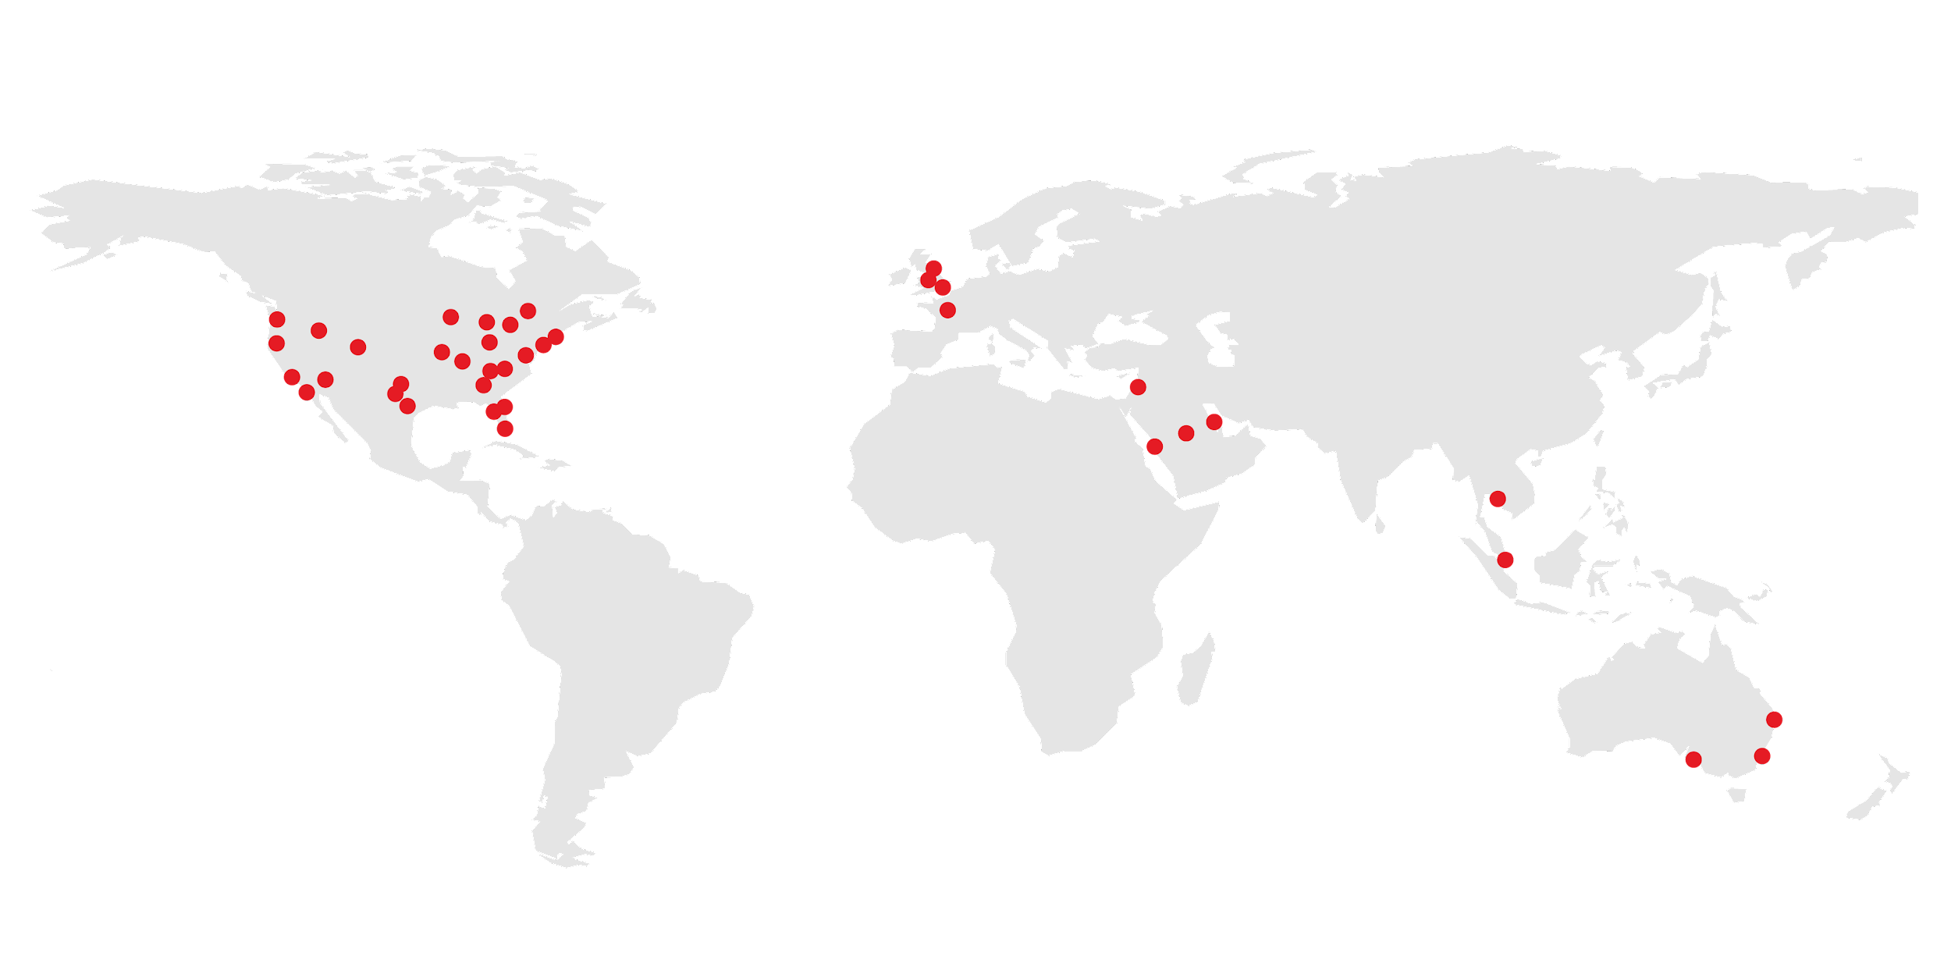
General Assembly is a pioneer in education and career transformation, specializing in today's most in-demand skills. We foster a flourishing community of professionals pursuing careers they love.
‹#› | © 2020 General Assembly
Notes:
So, who are we and why are you here? General Assembly — “GA” — is a global education institution that specializes in the most in-demand skills across data, design, technology, and business.
We offer classes, workshops, and courses in web development, design, digital marketing, data science, and business with a range of commitment options.
As part of helping individuals like yourselves acquire new skills and/or transition into a new career, we also work with a global network of employers as a source of talent. More than 9,000 of our Immersive graduates have been hired into tech careers!
TALKING POINTS:
General Assembly was founded in NYC 2011 as a coworking hub for innovators and entrepreneurs.
When our members were asked to share their expertise with one another through impromptu classes and workshops, the potential and power of peer-to-peer mentorship emerged.
We now offer courses online and at 30+ campuses around the world. We also work with businesses and have trained more than 40 of the Fortune 100 companies!
We’re most proud of our 70,000+ part- and full-time alumni, as well as the 500,000 alumni of our workshops and bootcamps — all of whom were taught by active industry professionals.
Our curricula are developed in collaboration with our expert network to emphasize real-world relevance and meet evolving employer demands.

Slide 7




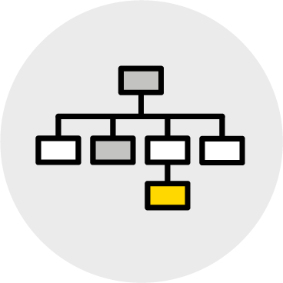

What We Teach
Coding
UX & Design
Data
Marketing
Business
Career Development
‹#› | © 2020 General Assembly

Slide 8

Meet Your Instructors <Bio Slide Optional>
{Your Name}
Title, Current Positions
{Bio Info}
{Insert picture}
‹#› | © 2020 General Assembly
Notes:
Tonight we’re joined by {instructor} who teaches {course}.
You also have probably already met (mentor), who is an alumni of {course} and will be here to help you with any issues that arise during the workshop. Just flag them down. (NOT YET FULLY IMPLEMENTED)
As a final note before we get started, you will receive a follow-up email after this workshop with:
All of the slides from tonight and course information.
A screencast of this lecture. (NOT YET IMPLEMENTED)
The example we’ll work through together.
I’m going to hand things over to {instructor}, who will give you some more info about their background.

Slide 9

Meet Your Classmates
5 minutes
Customize It!
There’s a lot of work ahead, and you’re going to need fuel.
Please share:
Your name.
Why you’re taking this course.
Your favorite comfort food.
Notes:
Purpose: spend a few minutes “breaking the ice” and getting people comfortable.
Teaching Tips
If you have a large class (20+), don’t have everyone introduce themselves out loud. Instead, have them post their answers in Slack, then call out a few highlights.
Customize It! Change the fun fact (number 3) to another. Avoid sensitive topics.
For remote classrooms:
Have students come off of mute to share their answers.

Slide 10

Storytelling by Nespresso
Customize It!
Source: Nespresso ad
Notes:
Purpose: Kick it all off with an interesting real-world example of digital marketing.
TEACHING TIPS:
Link to video: https://www.youtube.com/watch?v=goorklU35-8
If the embedded YouTube video doesn’t work try: http://www.dailymail.co.uk/tvshowbiz/article-4448426/George-Clooney-hitches-iconic-movie-rides-Nespresso-ad.html#v-5675542303302501281
Customize It!
Replace this with another campaign that demonstrates the impact a successful marketing campaign can have on a business.

Slide 11
Marketing will no longer be seen as a cost center but instead as a growth center — a key, unquestioned driver of business revenue.
Customize It!
— Astha Kalbag
Marketing Science Expert for Facebook
Source: Digital Branding Institute
Notes:
Purpose: Summarize why digital marketing is critical to business and therefore a great “skill” to have.
TALKING POINTS:
Astha Kalbag, a marketing science expert for Facebook deemed one of the “digital marketing thought leaders in Asia,” sums up the importance of marketing in one sentence.
TEACHING TIPS:
More about Astha here: https://mooketing.com/about/.
Customize it!
Replace this quote with another that speaks to the importance of marketing. We want this quote to inspire students and affirm that they are in the right place, learning a crucial and in-demand skill set.

Slide 12
Introduce the Project
Activity + Debrief Guide
Before jumping into the meat of the day, you’ll need to introduce the project.
Overview
Throughout the day, students will make incremental progress on an in-class project. After each module of the course (Objective-First Marketing, The ABC’s of KPIs, etc.,) they’ll have the opportunity to apply what they’ve learned. Students will act as the marketing department to plan a campaign using the Objective-First Framework. They will do so using the Campaign Plan Worksheet.
For the Activity That Follows...
Introduce the project at a high level, then give students five minutes or so to select the company for which they’d like to design a campaign. They can choose the company they currently work for or select one of the scenarios provided.

Slide 13

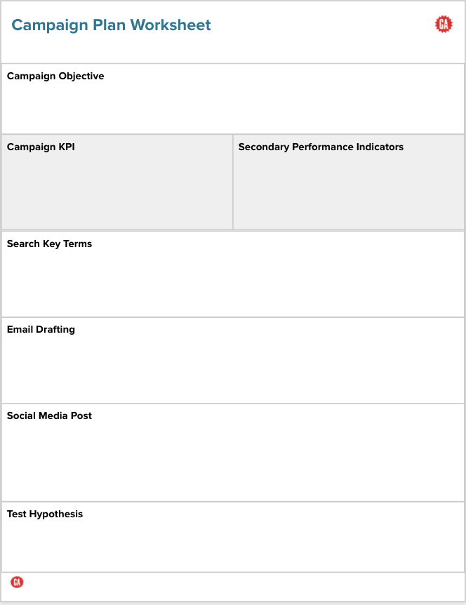
Your Challenge
5 minutes
Campaign Plan Worksheet
Throughout the day, you’ll apply what you learn to plan a campaign using the Campaign Plan Worksheet.
For this exercise, you can either use the company you currently work for or select one of the provided scenarios.
Take a moment now to determine which company you’d like to “work for” for the next seven hours.
Notes:
Purpose: Introduce the in-class project.
TALKING POINTS:
General Assembly is all about providing hands-on learning opportunities.
This project will give you an opportunity to practice and apply what you learn in each section, share your plans, and get feedback from each other and from me.
TEACHING TIPS:
Send the link to the scenario prompts for students who are not using the company/product they work for.
Send the link to the Campaign Plan Worksheet featured in the slide above. Alternatively, students can use a printed version.

Slide 14
Objective-First Framework
Digital Marketing Bootcamp
Objective-First Marketing
The ABCs of KPIs
Channels and
Design Tactics
Optimization
Notes:
Duration: 60 minutes

Slide 15

What’s Coming
Explain the Objective-First Framework and its importance in creating a successful campaign.
Write a SMART objective for your campaign.
‹#› | © 2020 General Assembly
Notes:
Purpose: Highlight the learning objectives that we’ll tackle in this section.

Slide 16
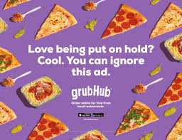

Tally the Decisions
Customize It!
For this campaign, the marketers at GrubHub had to decide:
What are they marketing?
How should they market it?
Where should they do it?
Who are they targeting?
How will they know if it’s working?
What would make it more effective?
That’s a lot of decisions!
Notes:
Purpose: Help students realize just how many decisions go into a marketing strategy.
TALKING POINTS:
There are a lot of decisions that go into any given marketing campaign.
What are they marketing? The speediness of their platform or the fact that users can order from more than 120,000 restaurants?
How should they market it? In a blog post? In a video? A display ad?
Where should they do it? On Facebook? On a billboard? In a search engine?
Who are they targeting? New users? Repeat users? A certain age group?
How will they know if it’s working? Are we measuring new sign-ups? New orders? Repeat orders?
What would make it more effective? Different copy? Targeting different people?
Customize It!
Replace this with another campaign that might resonate more with your audience.

Slide 17
Marketers Face Endless Decisions
What to Do
TV
Display ads
Video
Mobile ads
Native ads
Audio ads
Blogging
Content
Influencer marketing
Where to Do It
Facebook
Instagram
Snapchat
LinkedIn
WeChat
Email
Websites
Affiliates
Publishers
TV
Out of home
Who to Target
Demographics
Psychographics
Time of day
Day of week
Behaviors
Contexts
Devices
Locations
Emotions
What to Measure
Impressions
Reach
Frequency
Views
Clicks
Engagements
Interactions
Time spent
Repeat visits
Repeat usage
Conversions
Revenue
Efficiency rates
How to Optimize
Adjust targeting
Change messaging
Change creative
A/B test
Adjust channel mix
Notes:
Purpose: Underscore the massive number of decisions marketers face when designing campaigns.
TALKING POINTS:
The decisions fall under five main categories: what to do, where to do it, who to target, what to measure, and how to optimize it.
TEACHING TIPS:
This slide serves as a summary to the questions on the previous slide. You should lightly touch on the categories, but there’s no need to read everything.

Slide 18

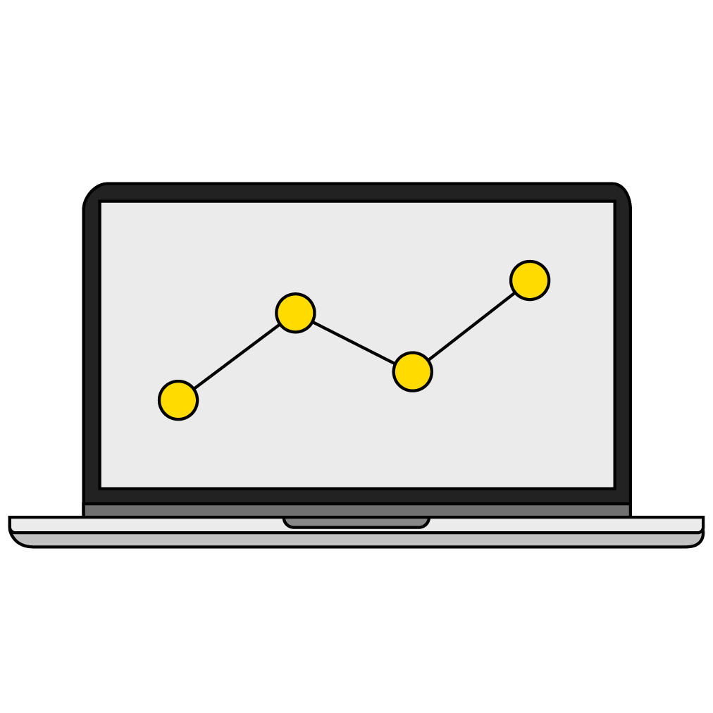
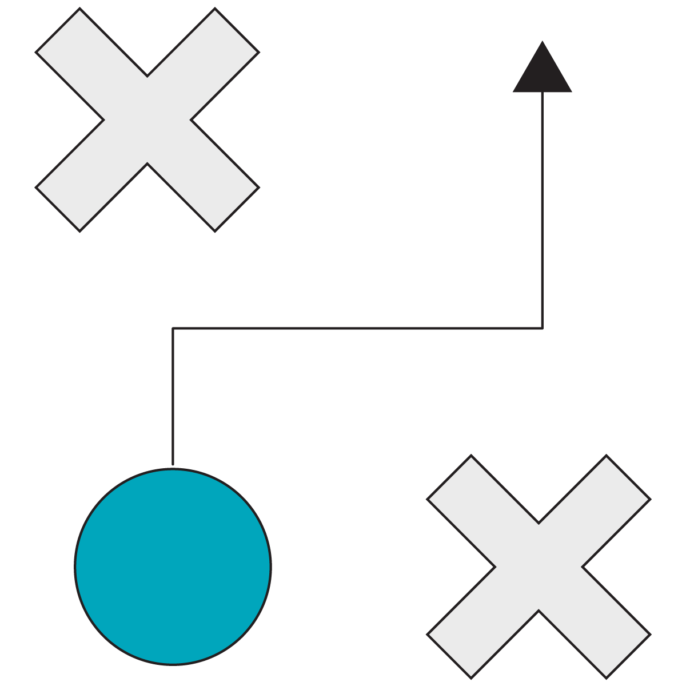


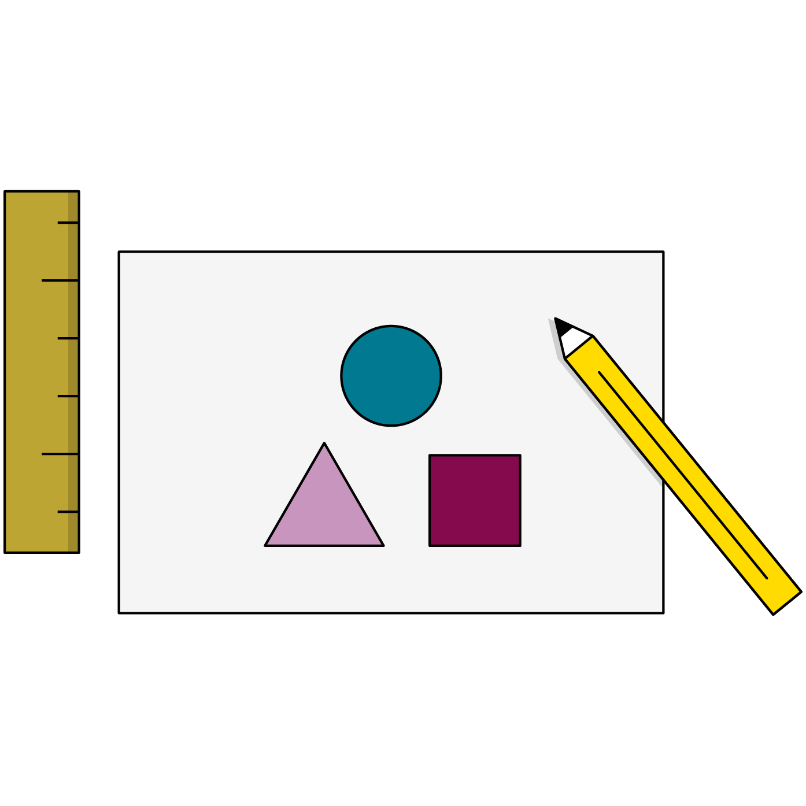
Meet the Objective-First Framework
Set
Objectives
Define
KPIs
Design
Tactics
Execute Campaign
Measure Outcomes
Optimize
Results
Planning
Execution
Notes:
Purpose: Introduce the Objective-First Framework.
TALKING POINTS:
The Objective-First Framework is how we approach structuring marketing campaigns in a way that’s goal-oriented, data-driven, and customer-focused.
We’ll structure the program around each piece of the framework, digging into each step throughout the day.
You’ll have an opportunity to apply each step of the framework to a sample scenario.

Slide 19
From the Top
Set
Objectives
Define
KPIs
Design
Tactics
Execute Campaign
Measure Outcomes
Optimize
Results
Planning
Execution
Notes:
Purpose: Provide context on where we’re starting: setting objectives.

Slide 20
Jake Wants to Run
Jake wants to run a marathon.
He trains, he changes his diet, and he buys running shoes and other fun running accessories.
Jake signs up for a marathon. Come race day, Jake runs for two-thirds of the race and walks the final third.
Did Jake achieve his goal?
Notes:
Purpose: Provide a scenario that explains why SMART objectives are important.
TEACHING TIPS:
Lead a discussion on whether or not Jake achieved his goal. Encourage good, healthy debate.
Draw a comparison that, if Jake’s goal were a marketing objective, then the marketing team may have to convince the CMO that it did indeed achieve its goal.
We want a clear “yes” or “no” answer when we ask “Did we achieve our marketing objective?”
Pose the same question if we change Jake’s goal to something more specific “complete a marathon in under four hours” or “finish a marathon without walking,” etc.
For remote classrooms:
Have students come off mute and share their responses aloud.

Slide 21
The “Why”
Why We Start With Objectives
Align the entire team on a clear and measurable goal.
Determine the marketing tactics that best support the objective and resonate with customers.
Enable insightful decision-making based on data and goals.
Notes:
Purpose: Summarize the importance of starting with objectives.
TEACHING TIPS:
Connect these points back to anything that came up in the discussion from the previous slide.

Slide 22



A Good Objective…
Ladders up.
Is SMART.
Ties to the funnel.
Notes:
Purpose: Clearly delineate what makes a good objective.
TALKING POINTS:
We’ll dive further into each of these components in the section to come.
Digital marketing campaigns are defined by SMART objectives that ladder up to business goals and tie into the funnel.
SMART objectives are specific, measurable, achievable, results-oriented, and time-bound. We’ll talk more about this later.
By “ladders up,” we mean that the campaign objective can be tied to an overall business objective and piece of the company roadmap. It’s not a rogue objective out on its own.

Slide 23
Laddering Objectives
Few
Business
Broad, company-wide goals created by senior leadership to guide decisions across the business.
Marketing
Marketing team goals that directly drive to business objectives and are the measure of success for the team.
Campaign
Change a specific perception or behavior of a target audience in a quantified way over a set period of time.
Channel
Channel
Improve performance of specific channels in support of and separate from specific campaigns.
Many
Notes:
Purpose: Introduce what objectives look like at various levels of the organization.
TALKING POINTS:
A strong marketing strategy allows you to connect objectives from individual marketing channels all the way up to the overall vision of the business. It allows you (or anyone to whom you’re talking) to connect the dots and ensure that you’re spending time in your day-to-day work in ways that align with the larger business goal.
Let’s look at an example in action (on the next slide).

Slide 24

Barbie: Imagine Possibilities
Customize It!
Turn around a declining business in a recovering category.
Business
Shift perception among Barbie purchasers (i.e., millennial moms) to drive reappraisals of the brand.
Marketing
Decrease negative social sentiment by 100% this quarter.
Campaign
Generate 1,000 pieces of user-generated content on Instagram.
Channel
Notes:
Purpose: Bring to life the idea of laddering objectives.
TALKING POINTS:
Here’s how laddering objectives played out for Barbie’s “Imagine Possibilities” campaign.
Customize It!
Replace this with another example. Be sure to include objectives for each tier of the pyramid.

Slide 25
The SMART Framework
S
M
A
R
T
Specific
Goal is clearly defined.
Measurable
KPI is identified and you have access to the necessary data.
Attainable
Feasible based on historical data and budget.
Relevant
Ladders up to an objective above it.
Time-Bound
Clear start and end dates for measurement are provided.
Notes:
Purpose: Introduce the SMART framework as a way of setting strong objectives.
TEACHING TIPS:
Walk through the meaning of each letter in the SMART acronym.

Slide 26
Outcomes + SMART
Customize It!
S
Our goal this quarter is to drive sales by increasing email conversion rates to 2.5% using list segmentation.
M
T
A
Historical metrics show that current conversion rates are at 1.8% without segmentation.
Email is an important channel for us, representing 20% of all marketing revenue.
R
Notes:
Purpose: Dissect a SMART objective.
TALKING POINTS:
The historical context that conversion rates are 1.8% without segmentation gives us good insight that the 2.5% measurable goal we want to achieve is actually doable.
We know that email marketing accounts for 20% of all revenue, so it’s an important channel to focus on, making it a relevant metric.
“This quarter” makes the objective time-bound, meaning we have an end date at which we’re going to measure the success of this initiative. In other words, it doesn’t remain open-ended, which would make it challenging to measure.
Specific: There are many ways to slice and dice measuring the efficacy of an email campaign. We’ve chosen specificity by electing to focus on email conversion rates.
Customize it!: Replace this with another example objective that may be more relevant to your audience.

Slide 27
Which Is SMART?
1
2
Increase the conversion rate for our flagship product by 10% in Q4.
Improve conversion rates in areas of strategic importance to the local business​.
Notes:
Purpose: Give students an opportunity to identify a SMART objective.
TEACHING TIPS:
Give students a moment to think then have everyone hold up their fingers to indicate their answer (1 or 2).
Have someone share why they think their answer is right.
Reveal that the answer is number 1.
Specific: It’s tied to a specific product (“the flagship product”).
Time-bound: This is supposed to happen in Q4.
Measurable: We can measure 10%.
Relevant: It involves our flagship product, which makes it relevant to the business.
Anything else?
For remote classrooms:
Slack the question: “Which objective is SMART?” and add emojis for numbers 1 and 2. Have students respond with the emoji they think is correct. Then, foster a discussion via Zoom.

Slide 28
That Pesky “A”
How do we know if it’s “attainable” ?
Your historical data.
Shooting low to start.
Benchmarks from your industry.
Current events and climate.
Absolute business needs.
Notes:
Purpose: Review different data sources that will help you understand if an objective is “attainable.”
TALKING POINTS:
“Attainable” can be a tricky one for people to suss out — it can be somewhat subjective. What does it mean?
Our goal is to answer these questions: What do good channel results look like? How do you know they’re good?
Attainable doesn’t have to be subjective. What can we use?
Historical data: What has your organization achieved before in past campaigns or projects?
Industry benchmarks: Where can you find the appropriate benchmarks for your industry?
Absolute business needs: What is the absolute business need, and does our proposed objective align with it?
Shooting low to start: Set your goal low to start if you aren’t yet quite sure what attainable means.
Current events: Are there major events going on in the world/in the region that might impact performance? (For instance, if I had a company that sold "VOTE" T-shirts, my goal for website visitors would be higher during the month of October given current events.)

Slide 29
Objective Mad Libs
“Our objective this [time frame] is to drive [specific and tied to business model] from [X] to [Y].”
Raise brand awareness this month by driving 10,000 new unique visitors to the website.
Get 1,000 free online demo sign-ups by education companies this quarter.
Our objective this financial year is to acquire 500 new customers.
Notes:
Purpose: Provide “plug and play” option for writing SMART objectives.
TALKING POINTS:
There are many ways to write a SMART objective, but this Mad Libs template is a helpful formula.

Slide 30
Rewrite These to Be SMART-er
5 minutes
Customize It!
Increase followers by the end of this quarter.
Raise brand awareness by giving users trial versions of education software.
Have new customers by the end of this quarter.
Grow our client base.
Notes:
Purpose: Practice identifying a bad marketing objective and revising it using the SMART framework.
TEACHING TIPS:
Give students 10 minutes to read through each objective and talk through what’s missing and what additional information would be needed to make it a stronger objective.
Answers:
Growth needs to be more specific and measurable (e.g., Increase Instagram followers by 300% by the end of Q1).
Objective needs to be time-based (e.g., Raise brand awareness by the end of this fiscal year by giving users week-long trial versions of education software).
Needs to be more measurable (e.g., Have 1,000 new customers by the end of Q3).
Objective needs to be more specific (e.g., Grow our client base by 400% by discounting the first week of the subscription cost for streaming services).
Customize it!: Replace these non-SMART objectives with other examples.
For remote classrooms:
Put students into breakout rooms of 2-3.
Screenshot the slide and drop it in the Slack channel.
Ask students to thread their noticings. They do not need to wait to press enter - similar to "calling out" in a physical classroom.

Slide 31
Objectives Are Based on the Funnel
Brand marketing:“I want to make people aware and excited about what we have to offer!”
Customer acquisition: “I want to grow my bottom line by gaining new customers.”
Retention and loyalty: “I want to engage my customers and get them to buy more!”
Awareness
Consideration
Conversion
Retention
Notes:
Purpose: Give students an understanding of the marketing funnel and how objectives fit within it.
TALKING POINTS:
The third and final quality of objectives is that they are based on the sales/marketing funnel. (The other two are SMART and “ladders up”).
At any given time in their journey with your brand, users will fall within the marketing funnel. Our job as marketers is to move prospective customers from being “aware” of our brand to being loyal and retained customers.
The marketing funnel is a useful reference point — typically your objectives fall somewhere within or are related to this framework.
Additionally, for your objective to be SMART, it will likely only address one stage of the funnel, otherwise it may be too broad or trying to do too much.
TEACHING TIPS:
Give a high level overview of the funnel. You can use the explanation provided in Bullet 2 and/or elaborate on your own. Students only need a basic understanding of the funnel in order to understand that objectives typically align with one stage.

Slide 32
Campaign Objective
Activity + Debrief Guide
Activity
Give participants 10 minutes to work through the campaign objective. Intervene with any teams/individuals that seem to be stuck, but give them the full 10 minutes if they are working some things out.
Note: We expect students to struggle with the “attainable” element, considering they likely don’t have industry benchmarks or historical data. Coach students as you see fit but be sure to emphasize to them that it’s OK if they don’t have a perfect “A” right now.
Debrief
You will have about 5 minutes to debrief this activity:
Have all students share their objective in Slack. This way you can spot-check everyone’s, regardless of whether or not they volunteer for the next step.
Ask a few students to volunteer to share their objective for “critique.”
Write “SMART” on a whiteboard (or shared screen, if remote) and take some notes that demonstrate each characteristic as each student shares.

Slide 33
Write a Campaign Objective
10 minutes
Campaign Plan Worksheet
Write a SMART objective for your campaign based on the scenario you’ve chosen.
Be prepared to share your work with the class when you’re done!
Notes:
Purpose: Give students a chance to write a campaign objective.
TEACHING TIPS:
Ten minutes for the activity.
Five minutes to debrief.

Slide 34

Break
Notes:
Purpose: A break/lunch slide to show where we are on today’s agenda.
TEACHING TIPS:
Feel free to move this slide to a “pause” point that makes sense for your cohort.

Slide 35
The ABCs of KPIs
Digital Marketing Bootcamp
Objective-First Marketing
The ABCs of KPIs
Channels and
Design Tactics
Optimization
Notes:
Duration: 60 minutes

Slide 36
Where We’re Going
Differentiate between KPIs and metrics.
Choose the right KPI and actionable metrics for your campaign.
Notes:
Purpose: Highlight the learning objectives that we’ll tackle next.

Slide 37
Where Are We?
Set
Objectives
Define
KPIs
Design
Tactics
Execute Campaign
Measure Outcomes
Optimize
Results
Planning
Execution
Notes:
Purpose: Reorient where we are in the framework.
TALKING POINTS:
In the previous section, we learned about creating SMART objectives. Now that we’ve done that (and only now that we’ve done that), we can choose appropriate key performance indicators (KPIs).
Choosing the appropriate performance indicators is important because, as a digital marketing professional, we want to make sure that we are creating metrics of success that measure the effectiveness of a campaign.

Slide 38
What’s a Key Performance Indicator?
Metric: Any measurement.
Key performance indicator (KPI): A specific metric that determines whether or not you’ve successfully met your objective.
Metric
KPIs
Notes:
Purpose: Further underscore the difference between KPIs and metrics. Demonstrate that not all metrics are KPIs, but KPIs are a type of metric.
TALKING POINTS:
“KPI” stands for key performance indicator. A KPI is the metric you prioritize as the most important in tracking progress toward your objective. It is a specific metric that determines success.
You know that saying, “All squares are rectangles, but not all rectangles are squares”? The relationship between metrics and KPIs is similar.
Many metrics can be KPIs, depending on the goal of your objective. But, not all metrics are KPIs. Be careful not to use the terms interchangeably.
The best metrics are those that are actionable, meaning, they tie specific and repeatable actions to observed results.
TEACHING TIPS:
Provide an example of a KPI for a campaign on which you’ve worked. What about a metric you used? (This helps students delineate between the two concepts in a way that is applicable to their business.)

Slide 39
Common Metrics: Awareness
Awareness
Scale Metrics | Efficiency Metrics
Reach Impressions Frequency Video views Brand mentions Brand favorability Ad recall | Cost per 1,000 impressions (CPM) Cost per view (CPV)
Consideration
Conversion
Retention
Notes:
Purpose: Introduce common actionable metrics using the funnel as a guide.
TALKING POINTS:
Grouping metrics based on the phase of the marketing funnel with which they align is a useful way to understand what metrics (and thus what KPIs) you should be analyzing.
These are important metrics for the “awareness” phase of the funnel.
Scale versus efficiency is another way to categorize metrics.
Scale metrics: Metrics that measure volume.
Efficiency metrics: Metrics expressed as a ratio.
TEACHING TIPS:
Instructors should provide an example of a campaign in which they used awareness metrics.
Ask students if they have had experience with awareness metrics or can think of examples involving awareness metrics.

Slide 40
Common Metrics: Consideration
Awareness
Scale Metrics | Efficiency Metrics
Engagement (likes, comments, follows) Clicks Visits Repeat visits Shares Completed views Time on page | Click-through rate Cost per click View-through rate Cost per view Engagement rate Cost per engagement
Consideration
Conversion
Retention
Notes:
Purpose: Explain where actionable metrics fall in the different phases of the funnel.
TALKING POINTS:
These are important metrics for the “consideration” phase of the funnel.
When thinking about consideration metrics, keep in mind how you interact with products/applications that are in the market, whether it be Facebook or Instagram.
When tracking these considerations, these serve as metrics to help ensure and track the efficiency of a campaign.
TEACHING TIPS:
Ask: Can anyone think of any other metrics that are relevant here?
Ask: Has anybody seen how these metrics are tracked on different social media platforms?

Slide 41
Common Metrics: Conversion
Awareness
Scale Metrics | Efficiency Metrics
Leads Downloads Orders New customer acquisitions Time to purchase Purchases | Cost per lead Conversion rate Cost per acquisition Average order value ROI Return on ad spend
Consideration
Conversion
Retention
Notes:
Purpose: Explain where actionable metrics fall in the different phases of the funnel.
TALKING POINTS:
These are important metrics for the “conversion” phase of the funnel.
The purpose of the conversion phase is to actually be able to keep track of revenue generated by a campaign. We want to remember that the goal of any marketing campaign is not just about how many people are liking and sharing, but also how many are purchasing, downloading, and returning on investment.
TEACHING TIPS:
Ask: Can anyone think of any other metrics that are relevant here?

Slide 42
Common Metrics: Retention
Awareness
Scale Metrics | Efficiency Metrics
Repeat purchases Renewals Customer satisfaction Net promoter score (NPS) Monthly recurring revenue (MRR) Annual recurring revenue (ARR) | Churn rate Average customer lifetime value Retention rate
Consideration
Conversion
Retention
Notes:
Purpose: Explain where actionable metrics fall in the different phases of the funnel.
TALKING POINTS:
These are important metrics for the “retention” phase of the funnel.
When we think about retention metrics, we need to keep in mind that we want to have a consistent following. We need to ensure that we’re gathering data from customers, such as customer satisfaction, repeat purchases, and renewals.
TEACHING TIPS:
Ask: Can anyone think of any other metrics that are relevant here?
Be sure to explain the differences between customer satisfaction and NPS.
Be sure to explain the differences between monthly recurring revenue versus annual recurring revenue.

Slide 43
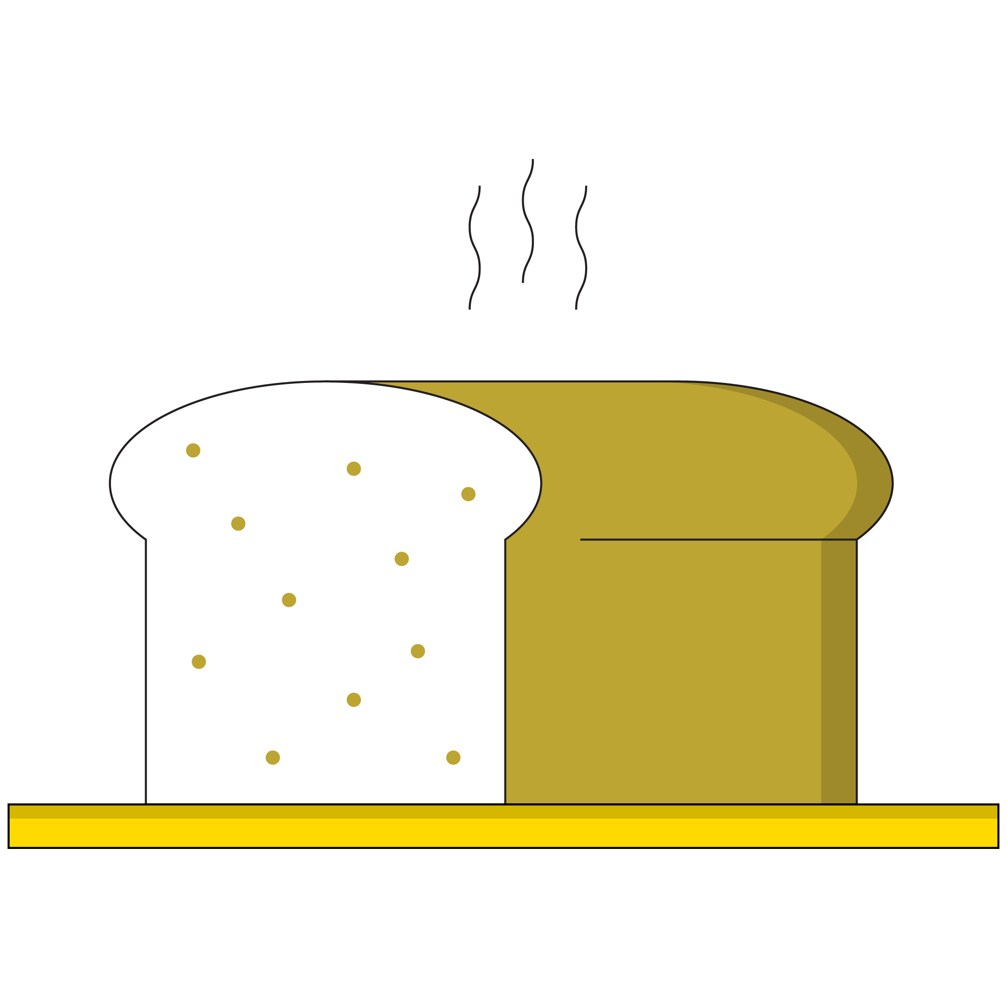
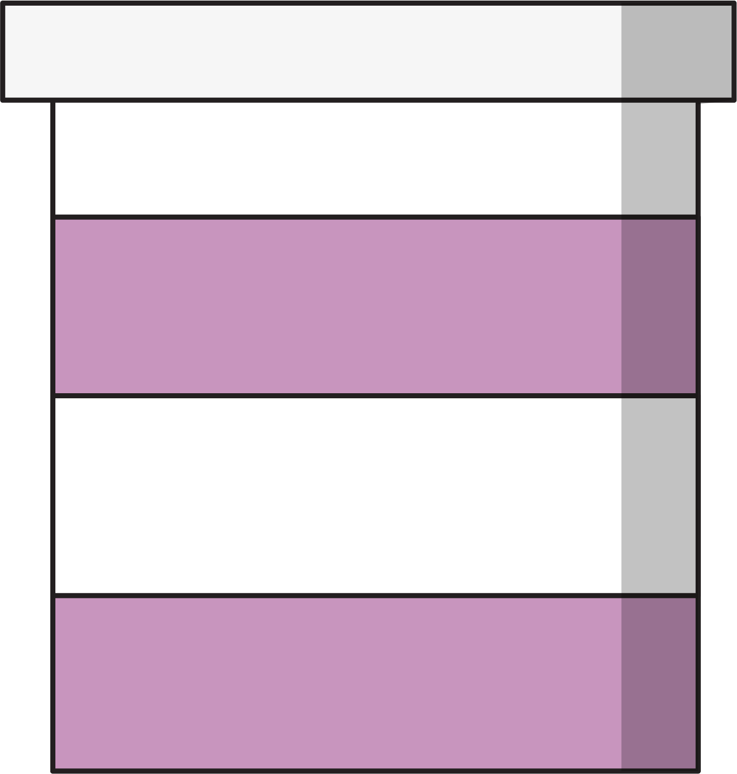
Objectives and KPIs Go Together Like…
+
Notes:
Purpose: Emphasize the important relationship between objectives and KPIs.
TALKING POINTS:
Setting objectives and choosing KPIs go hand-in-hand — you can’t have one without the other.

Slide 44
Selecting KPIs
Increase website visitors by 20% this quarter.
Increase Instagram engagement by 5% this month.
Generate 10% higher conversion rate this quarter.
Attain 100 new leads this month at a CPA of $40.
Website Visitors
KPI
Instagram Engagement Rate
KPI
Conversion Rate
KPI
Leads at $40 CPA
KPI
Notes:
Purpose: Provide a scaffolded opportunity for students to connect KPIs to SMART objectives.
TALKING POINTS:
Together, let’s select the appropriate KPI (using the bank on the right) for each of the four objectives on the left.
TEACHING TIPS:
Allow students time to think about each SMART objective and explain their reasoning behind connecting each SMART objective to the KPI.

Slide 45


Don’t Leave a KPI Lonely
KPI:
Specific metric that determines whether or not you’ve successfully met your objective.
Secondary performance indicators:
A metric(s) that tells you, in real time, if you’re on your way to success.
Notes:
Purpose: Explain KPIs and secondary performance indicators.
TALKING POINTS:
When we think about KPIs, we want to think about secondary metrics as well.
While there is only one KPI, there can be one or multiple secondary performance indicators that support it.
Think of the KPI as the big-picture goal we’re trying to achieve in our marketing campaign. We need to keep in mind, however, the smaller goals we’ve put in place to ensure that we are on track to reach our big-picture goal.
TEACHING TIPS:
Provide examples of a KPI and its associated secondary performance indicators.

Slide 46
KPIs and Secondary Metrics
Customize It!
Schedule 30 qualified interviewees for the product manager role by the end of the quarter.
KPI:
Number of interviews.
Secondary performance indicators:
Number of applicants, number of people viewing the job posting.
Notes:
Purpose: Provide a non-marketing related example of how KPIs and secondary performance indicators relate.
TALKING POINTS:
In this scenario, let’s say we’re hiring for a product management role and our goal is to interview 30 qualified candidates before hiring.
The metric that directly correlates to our success is the number of interviews we conduct.
The number of applicants and how many views our job posting receives are indicators of whether or not we’re on our way to success. These might be our secondary performance indicators.
Customize it!
Replace this non-marketing example with another that may resonate more with your audience. We suggest steering clear of anything related to weight or calorie counting, as these can be triggering for some students.

Slide 47
KPIs and Secondary Metrics (Cont.)
Drive awareness of the top three benefits of the product by 5%.
KPI:
Increase in awareness.
Secondary performance indicators:
Frequency, reach, CPM.
Notes:
Purpose: Bring to life the concept of a KPI and relevant secondary performance indicators in a marketing-related example.
TALKING POINTS:
Now let’s look at a marketing-related example with a KPI and its accompanying secondary performance indicators.
A company wants to increase its awareness on social media and it establishes this goal as the KPI. In order to make sure that it is moving closer to that goal, it will need to track the frequency at which it posts, how many people its posts reach, and its cost per mille.
Cost per mille refers to the cost an advertiser pays for 1,000 views or clicks on an advertisement.
TEACHING TIPS:
Walk through how the objective, KPI, and secondary performance indicators align.

Slide 48
KPI and Secondary Metrics
Increase website visitors by 20% this quarter.
Increase Instagram engagement by 5% this month.
Generate 10% higher conversion rate this quarter.
Attain 100 new leads this month at a CPA of $40.
Bounce Rate, Conversion Rate, New vs. Returning Users
CTR, Followers, CVR
Average Order Value (AOV), Website Visitors, ROAS
Reach, CVR, Total Leads
Notes:
Purpose: Provide a scaffolded opportunity for students to connect secondary metrics to a KPI.
TALKING POINTS:
Now, let’s all practice connecting KPIs to secondary metrics.
Take a few minutes to read each of these KPIs and think about which secondary metrics are appropriately associated with each.
Make sure you’re ready to explain why.
TEACHING TIPS:
Give students two minutes to read through the KPIs listed.

Slide 49
Campaign KPIs
Activity + Debrief Guide
Activity
This is an opportunity for participants to:
Think through the connection between objectives and KPIs.
Identify secondary performance indicators to align with their KPI.
Give participants 10 minutes to choose just one key KPI for their objective and 2–3 secondary performance indicators. Intervene if any students appear stuck, but give them the full 10 minutes if they are working some things out.
Debrief
You will have about 5 minutes to debrief this activity:
Have volunteers share their objective and their chosen KPI, as well as their secondary performance indicators. They should be able to explain why they chose that KPI and discuss its connection to the objective.
Classmates and/or instructors can vet each KPI and explain why.
Notes:
Purpose: Practice identifying KPIs.
Reference: Campaign Plan Worksheet.

Slide 50
Define KPIs
10 minutes
Campaign Plan Worksheet
For your campaign, choose one KPI that you’ll track to measure the success of your campaign objective.
Then, identify 2–3 secondary performance indicators to help you track progress toward your KPI.
Be prepared to share your work with the class when you’re done!
Notes:
Purpose: Get students to align on one primary KPI and multiple secondary indicators that they’ll use to track the success of the campaign objective they worked on earlier in this program.
TALKING POINTS:
Choose the KPI and the secondary performance indicators that will help you measure the success of your campaign objective.
TEACHING TIPS:
Ask the groups to share aloud and help workshop any groups that are having trouble. Help them understand why the chosen KPI might not be the most appropriate to measure their campaign objective.
Additional debrief instructions/questions are available on the previous hidden slide.
For remote classrooms:
Set up breakout rooms for students to work in independent small groups. This mimics the “table” format of an in-person class setting.
Screenshot this slide and post it in the Slack channel before opening the rooms.
At the 60-second mark, send a message to all rooms stating: “Start to wrap up your discussions. Rooms will close in one minute!”
Move around from breakout room to breakout room to effectively “walk around the classroom.”
Have students either come off mute to share their responses or share them in the chat.

Slide 51
Channels and Design Tactics
Digital Marketing Bootcamp
Objective-First Marketing
The ABCs of KPIs
Channels and
Design Tactics
Optimization
Notes:
Duration: 150 minutes (30 minutes before lunch, 120 minutes after)

Slide 52
Where We’re Going
Select the channel on which to run your campaign based on the objective and target audience.
Apply best practices to design the creative for your campaign.
‹#› | © 2020 General Assembly
Notes:
Purpose: Share the program learning objectives we’ll be covering in this section.

Slide 53
Where Are We?
Set
Objectives
Define
KPIs
Design
Tactics
Execute Campaign
Measure Outcomes
Optimize
Results
Planning
Execution
Notes:
Purpose: Provide context on where we’ve been and where we are now.

Slide 54
What Are Our Options?
Earned Media
Organic search results Social media
Product reviews
Word of mouth
Paid Advertising
Display ads
Search engine marketing
Video ads
Pay per click
Retargeting
Paid influencers
Paid content promotion
Sponsored posts
Social media ads
TV, magazines, radio, & OOH
Earned
Paid
Owned Content
Website
Mobile apps
Social media channels
Blogs
Email marketing
Physical locations
Owned
Notes:
Purpose: Provide an overview of the multichannel landscape: What’s at our disposal?
TALKING POINTS:
The three main categories of the multichannel landscape are: earned, owned, and paid.
Check out examples of each on the slide.
This model is a helpful way to think about all of our options.
TEACHING TIPS:
Ask students if they can think of ways in which companies utilize each channel from their perspective.

Slide 55
Let’s Compare!
5 minutes
Referencing each channel and their examples below, what are their unique benefits? Share out your ideas and think about how this applies to your project.
Owned Content
Website
Mobile apps
Social media channels
Blogs
Email marketing
Physical locations
Earned Media
Organic search results Social media
Product reviews
Word of mouth
Paid Advertising
Display ads
Search engine marketing
Video ads
Pay per click
Retargeting
Paid influencers
Paid content promotion
Sponsored posts
Social media ads
TV, magazines, radio, & OOH
Notes:
Purpose: Facilitate an open discussion to get students to evaluate the benefits of each channel.
TALKING POINTS:
Owned content: Examples include a website, an email newsletter, and social platforms (non-paid). Benefits include that they are:
Generally free.
Trusted by customers who land there.
Easy to tailor messaging.
Able to readily collect data on users to further personalize, remarket, and modify content.
Earned media: Examples include news mentions, a customer sharing a social post, and a customer tagging someone in a social post. Benefits include that they are:
Highest in terms of customer trust.
Viewed as the most authentic.
Generally free (most of the time).
Paid advertising: Examples include display ads, billboards, and paid social. Benefits include that they are:
Easily controlled; can be ramped up or down.
Useful for finding new consumers and clients.
For remote classrooms:
Have students come off of mute and share their responses aloud.

Slide 56
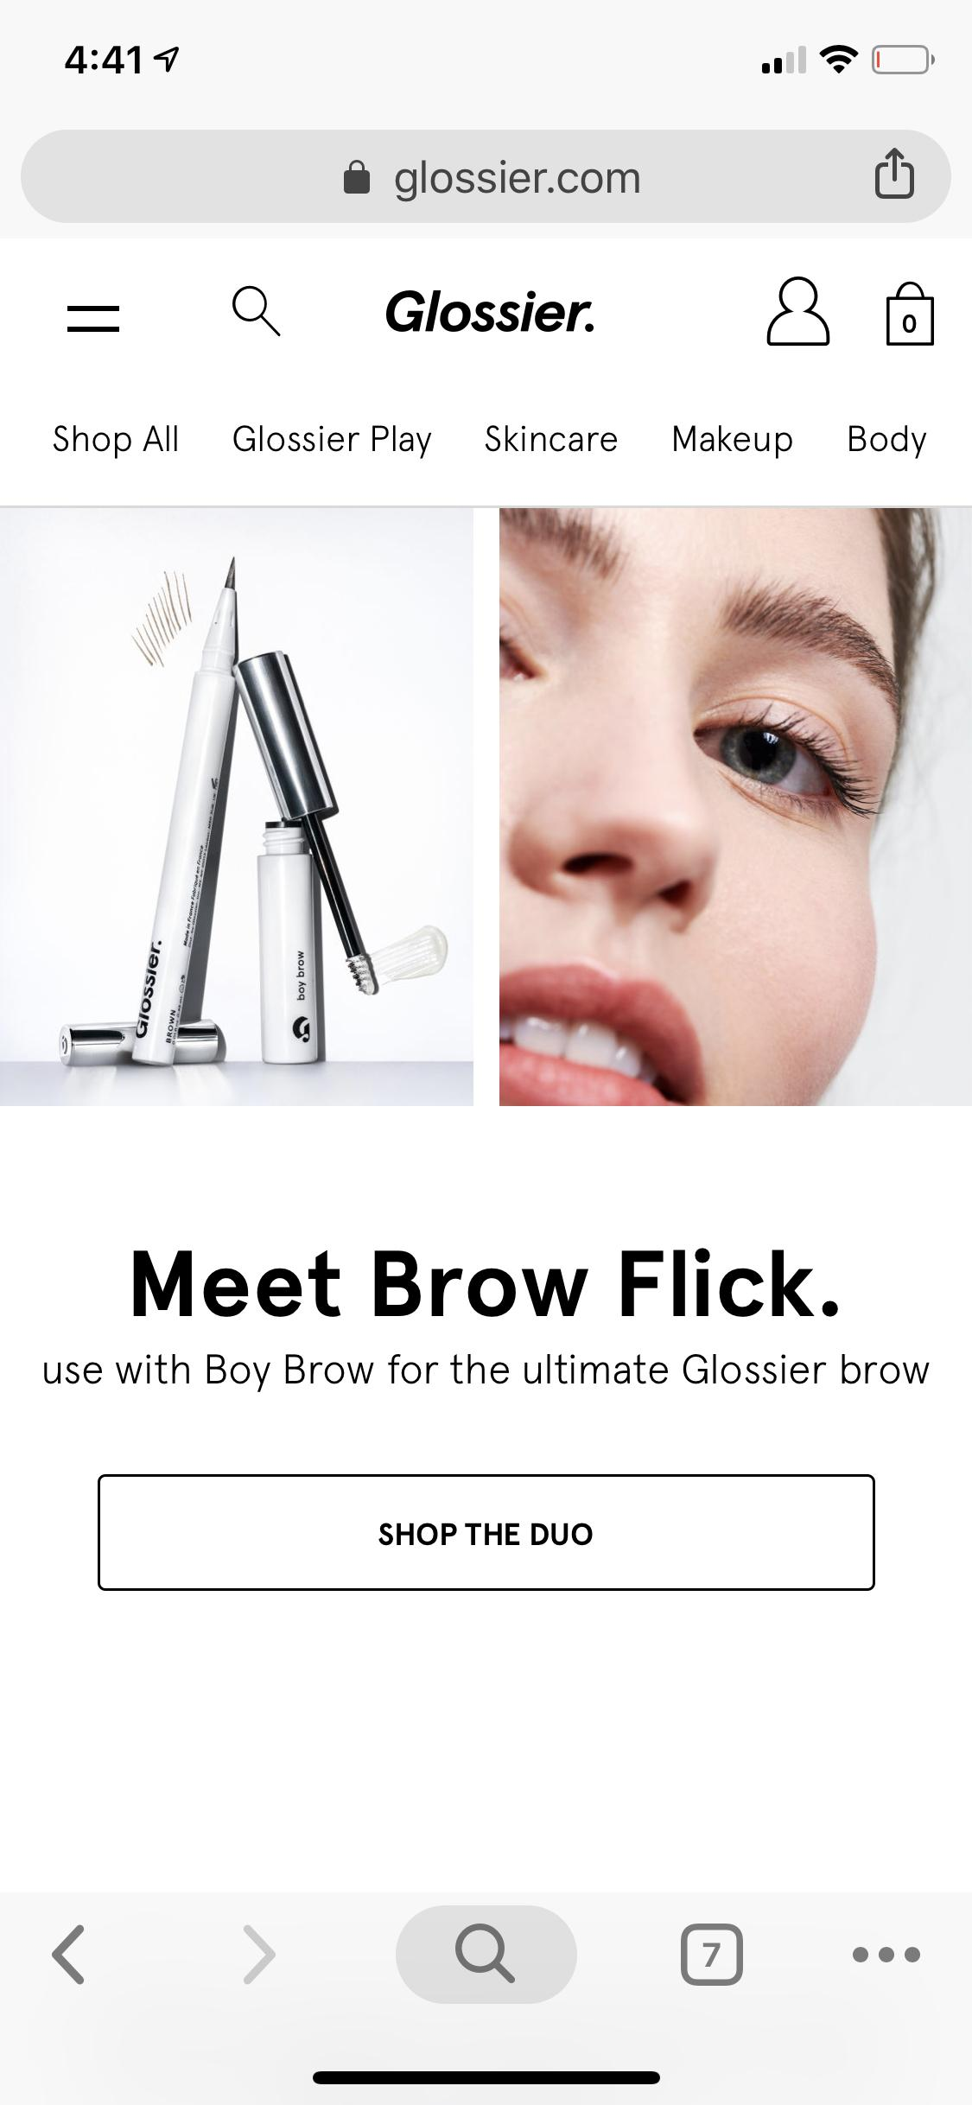
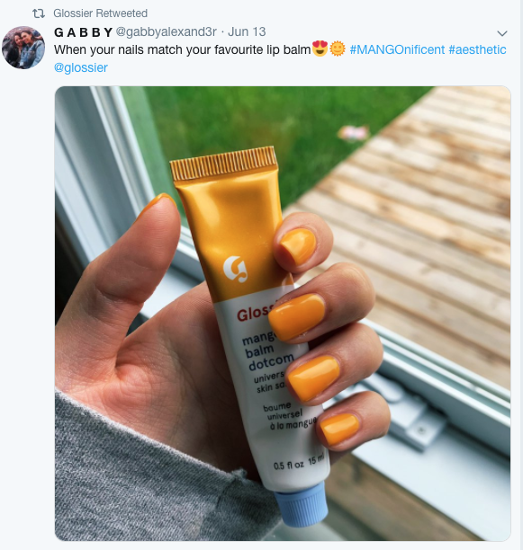

Owned
Earned
Paid
Notes:
Purpose: Facilitate an open discussion to get students to evaluate the benefits of each channel.
TALKING POINTS:
Owned content: Examples include a website, an email newsletter, and social platforms (non-paid). Benefits include that they are:
Generally free.
Trusted by customers who land there.
Easy to tailor messaging.
Able to readily collect data on users to further personalize, remarket, and modify content.
Earned media: Examples include news mentions, a customer sharing a social post, and a customer tagging someone in a social post. Benefits include that they are:
Highest in terms of customer trust.
Viewed as the most authentic.
Generally free (most of the time).
Paid advertising: Examples include display ads, billboards, and paid social. Benefits include that they are:
Easily controlled; can be ramped up or down.
Useful for finding new consumers and clients.
For remote classrooms:
Have students come off of mute and share their responses aloud.

Slide 57
Which Channel Will You Use?
10 minutes
As you begin to consider your project for the day, which channel do you think will best serve your objectives and help you reach your KPIs? Why?
Owned
Paid
Earned
Earned
Paid
Owned
Notes:
Purpose: Give student a chance to begin thinking about what channels they will be using for their projects.
TALKING POINTS:
Now that we’ve had a chance to talk through different marketing channels, which one do you think would be the best fit for your project based on the objective and KPIs you’ve established?
For remote classrooms:
Have students come off of mute and share their responses aloud.

Slide 58
An omnichannel approach puts the customer, not corporate silos, at the center of its strategy... It acknowledges that mobile and social have enabled customers to not only quickly switch between channels but actually use channels simultaneously.
— Stacey Schwartz Digital Marketing Program Director, Rutgers Business School
Source: Omnichannel vs.Multichannel Marketing
Notes:
Purpose: Provide more context around the fact that brands use multiple channels to connect with their customers.
TALKING POINTS:
Surprise! Most companies use the omnichannel approach because it focuses on the customer by recognizing that customers engage with brands in many different ways and across multiple platforms. This approach focuses on creating consistent experiences.
For example, customers can check out product reviews on their mobile phone while evaluating a product on a physical retail store shelf.
In the next section, we will talk in more detail about the different tactics used to execute marketing campaigns through these different channels.

Slide 59

Lunch!
Notes:
Purpose: A break/lunch slide to show where we are on today’s agenda.
TEACHING TIPS:
Feel free to move this slide to a “pause” point that makes sense for your cohort.
Important: Recommend optional activities for students to complete during lunch time. For example:
Explore the recommended readings at the end of this deck.
Continue to practice creating charts.
Revisit and refine the business questions they wrote down at the beginning of the lesson.
For remote classrooms:
Encourage students to stay in the Zoom room during lunch. This helps with networking, understanding attendee motivations, and building a shared sense of togetherness.

Slide 60
What We Cover for Each Channel
Overview: This section of the program is a “deep dive” into a select few marketing channels: search, email, social, and landing pages. Keep in mind that the deep dives are not exhaustive, but instead are designed to cover the essentials in order to encourage critical thinking and creative problem-solving on the part of the students. At their core, the deep dives serve to answer these key questions.
Part 1 (~10 minutes): Why is this channel important? Why might they use it over another channel? What benefits does it offer marketers?
Part 2 (~15 minutes): What does “good” look like for this channel? What are the best practices (generally and creatively speaking)?
Part 3 (~10 minutes): Any exciting trends? Best brands to watch?

Slide 61
Search
Channels and Design Tactics

Slide 62
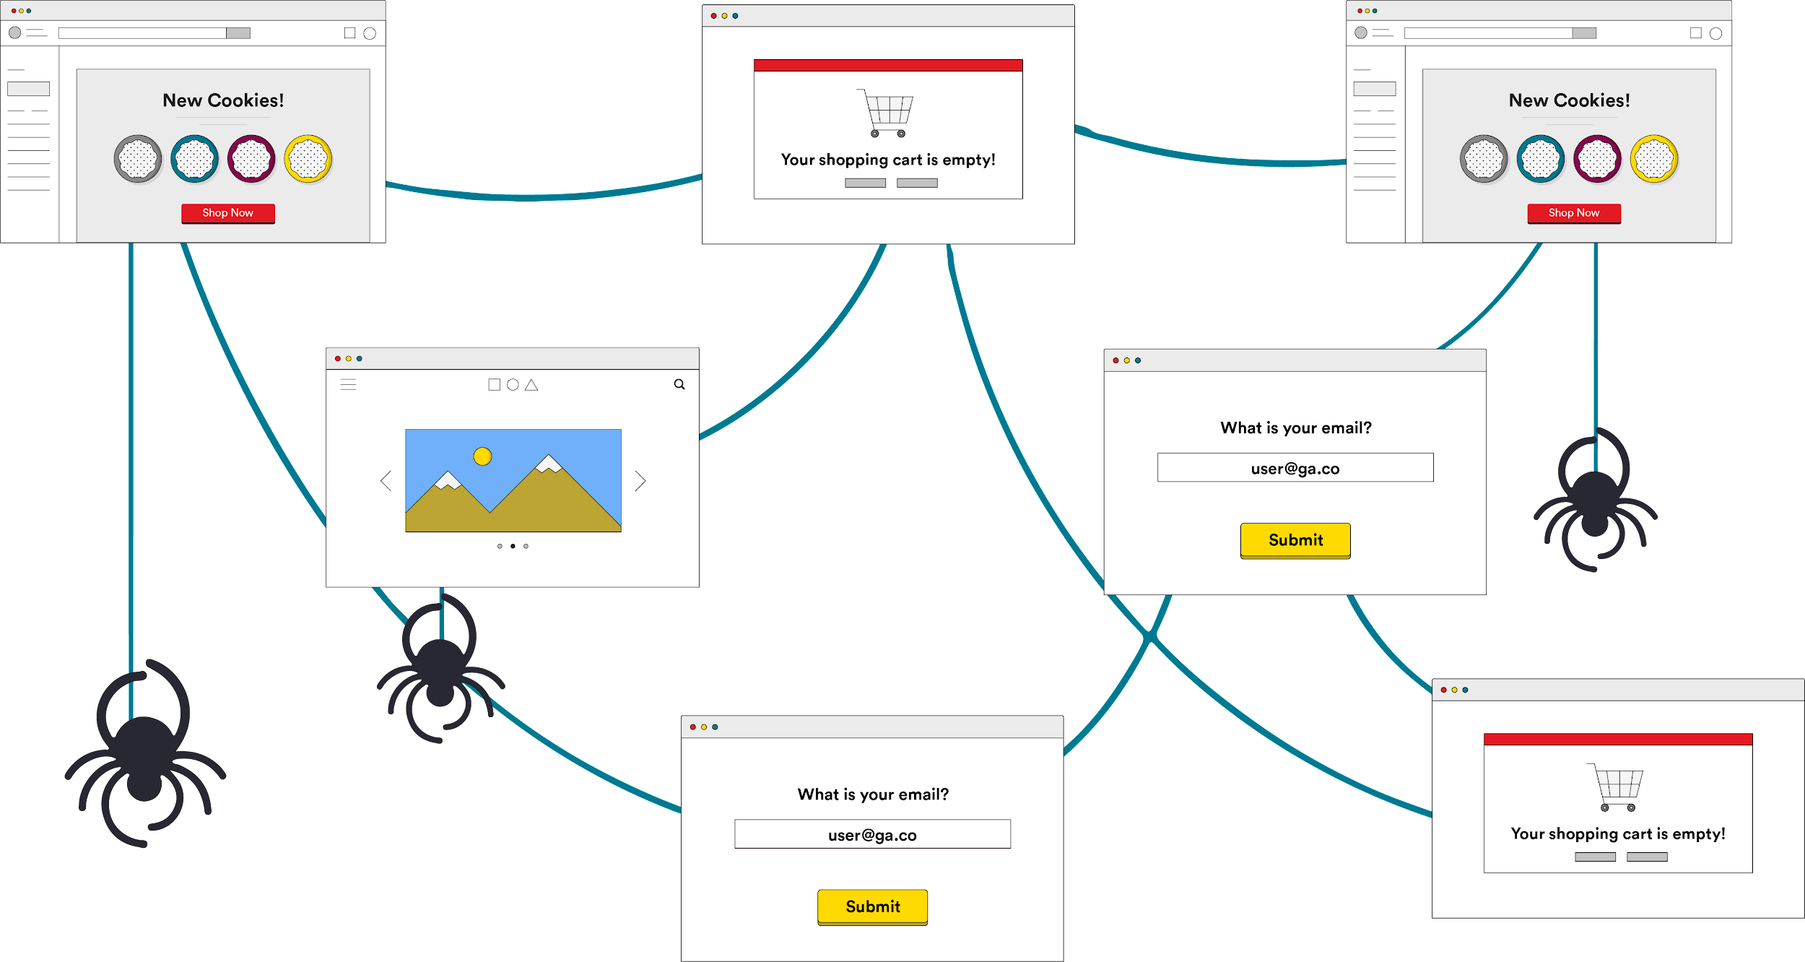
How Search Works
Crawl: Scours the internet for content, looking over the code/content for each URL it finds.
Index: Stores and organizes the content found during the crawling process. Once a page is in the index, it’s in the running to be displayed as a result to relevant queries.
Rank: Provides the pieces of content that will best answer a searcher's query, which means that results are ordered by most to least relevant.
Source: Beginner’s Guide to SEO
Notes:
Purpose: Provide background on how search works.
TALKING POINTS:
Search is commonly referred to as “search engine optimization,” or SEO. It is the practical increase, in both quality and quantity, of website traffic and brand exposure through organic (non-paid) and paid search engine results.
Search engines do all of this by discovering and cataloguing all available content on the internet (webpages, PDFs, images, videos, etc.) via a process known as “crawling and indexing” and then ordering it by how well it matches the query in a process we refer to as “ranking.”
TEACHING TIPS:
Get initial reactions from students.
Video from Google explaining how search works: https://www.youtube.com/watch?v=BNHR6IQJGZs&feature=emb_logo.
Moz guide to SEO: https://moz.com/beginners-guide-to-seo/why-search-engine-marketing-is-necessary.

Slide 63
SEO vs. Paid Search
1
2
Search Engine Optimization (SEO)
Optimize your site so that a search engine gives your site a high score based on the 200 questions it asks.
Paid Search (PPC)
Pay for an ad to appear on a search engine results page.
Notes:
Purpose: Define SEO and PPC in as few buzzwords as possible.
TALKING POINTS:
SEO is the practice of optimizing your site for the spiders that index the web. Matt mentioned that these “spiders” ask more than 200 questions about each page to determine whether or not it is a worthy result for a given search word. These questions include: How many times does a site use a keyword or words? Is the keyword in the URL? In header tags? How many other sites link to this site for this content? Etc.
In the video, Matt searched “Cheetah, Running, Speed.” These are his keywords.
Paid search is when you create a Google Ad for your product and you optimize that ad to be displayed to users who search for a given keyword or collection of keywords.
TEACHING TIPS:
If you want to replay the video now that we’ve defined these things:
SEO is covered at 0:50–1:55.
Paid search is covered at 2:30–2:55.

Slide 64
Organic Search (SEO)
Paid Search (PPC)
The long game.
Compounding ROI over time.
Costs = primarily labor.
You can only win through better content, structure, and domain authority.
Immediate return.
ROI only for as long as you’re spending.
Costs = pay per click.
You can win by spending a lot of money.
Notes:
Purpose: Compare SEO and PPC.
TALKING POINTS:
Both of these tactics are important for having a successful marketing strategy. As with anything, there are pros and cons to each.
Although there are many other aspects that contribute to search engine optimization, keywords are a major component; they’re also a major component in paid search.
So, this is where we will focus our attention today.
Next, we’ll begin to talk about keywords and how people search for things.

Slide 65
How People Search: Keywords
Informational
Transactional
Navigational
“How to buy small business insurance”
“Get insurance policy quote”
“State Farm small business insurance”
Notes:
Purpose: Explain how people use keywords to search online.
TALKING POINTS:
Whether it’s on- or off-site, search keywords are at the foundation.
Informational searches come from users with no particular brand preference who just want to get a question answered or find out more information about a topic. They provide brands the opportunity to give searchers meaningful content early in the research phase. For example, a small business owner searching for business insurance may make the informational search “How to buy small business insurance.”
Transactional searches may not have a specific brand in mind but are prepared to take an action, such as making a purchase or initiating contact with a sales rep. In this instance, the same small business owner would search for actionable terms like “Get insurance policy quote.” Keep in mind that there’s a lot of competition between brands for these keywords, as these searches show strong intent.
Navigational searches happen when a searcher is attempting to access an online destination of which they’re already aware. For example, in this scenario, the same business owner would search “State Farm small business insurance.” Navigational searches are the reason why it’s crucial for brands to have high and steady search rankings for their brand terms.

Slide 66
Keywords: Intent
LOW INTENT
MEDIUM INTENT
HIGH INTENT
“New sneakers”
“Nursery decor”
“Plumbing help”
“Nike sneakers”
“Crib mobile”
“Toilet repair”
“Red Nike running sneakers”
“Buy dinosaur crib mobile”
“Clogged toilet fix near me”
HIGH VOLUME
LOW VOLUME
LOW CONVERSION
HIGH CONVERSION
Notes:
Purpose: Showcase how intent plays into keywords.
TALKING POINTS:
The first step is to always be intentional with the types of keywords you select for both organic and paid search. More specifically, think about the objective for your search/business, and then determine what keywords make sense for you.
One of the first things that you want to think about is brand relevance. Questions to consider:
What's the relevance to my brand/product?
What’s the financial value of the keyword?
What’s the customer relevance?
Who is searching for this?
What’s the customer’s level of intent?
What is the search volume?
Who is the competition?
What sites are showing up and ranking?
How competitive is the search term?
Is it possible to compete on this term?

Slide 67
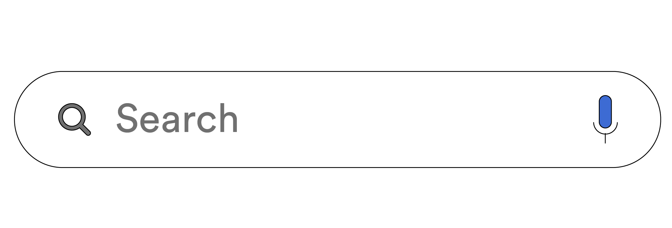
How Does Search Work?
Bob has a question about shoes and wants to search the internet for the best price. How does he do it?
Take a moment to think about the steps in detail, and jot down each step in order.
Notes:
Purpose: Walk through the process of how a customer might search for something.
TALKING POINTS:
We take search for granted, as it happens all day every day and is one of the most deeply ingrained digital behaviors. But let’s step back and answer exactly what happens when a real person makes a search query.

Slide 68
Search Overview
Bob wants new shoes.
Bob turns to a device to ask his question.
Bob opens a browser or platform.
Bob speaks or types his question.
The search engine results page (SERP) might suggest an autofill, and Bob might click on it.
Bob enters his search.
SERP looks at who Bob is and suggests some results.
Bob browses the results and clicks on one of them.
The page loads.
Bob looks at the page to find the answer to his question.
Bob might go back to the search list or he might keep looking at the site.
Notes:
Purpose: Provide a walk-through of how people search for things.
TALKING POINTS:
Here are some steps we came up with. Do you have more? Less? Any we don’t have here? What else might happen?
Collect answers from the class.
Questions to ask:
How did you ask your question?
What were some of your search results?
Why do you think these were your results?
What were the autofill options given?

Slide 69
Search Overview
Bob wants new shoes.
Bob turns to a device to ask his question.
Bob opens a browser or platform.
Bob speaks or types his question.
The SERP might suggest an autofill, and Bob might select it.
Bob enters search.
SERP looks at who Bob is and suggests some results.
Bob looks at the results and clicks on one of them.
The page loads.
Bob looks at the page to find the answer to his query.
Bob might go back to the search results list or he might keep looking at the site.
Device and user context matter.
Adapting to “natural language” matters.
Page load speed matters.
Great UX and content REALLY matter.
Notes:
Purpose: Provide a detailed walk-through of how people search for things.
TALKING POINTS:
Now, click on one of the links that came up from your search.
What do you notice about the website?
Consider how fast the page loads.
Think about the number of times “shoes” appears on the website.
What other keywords are relevant to your search?

Slide 70
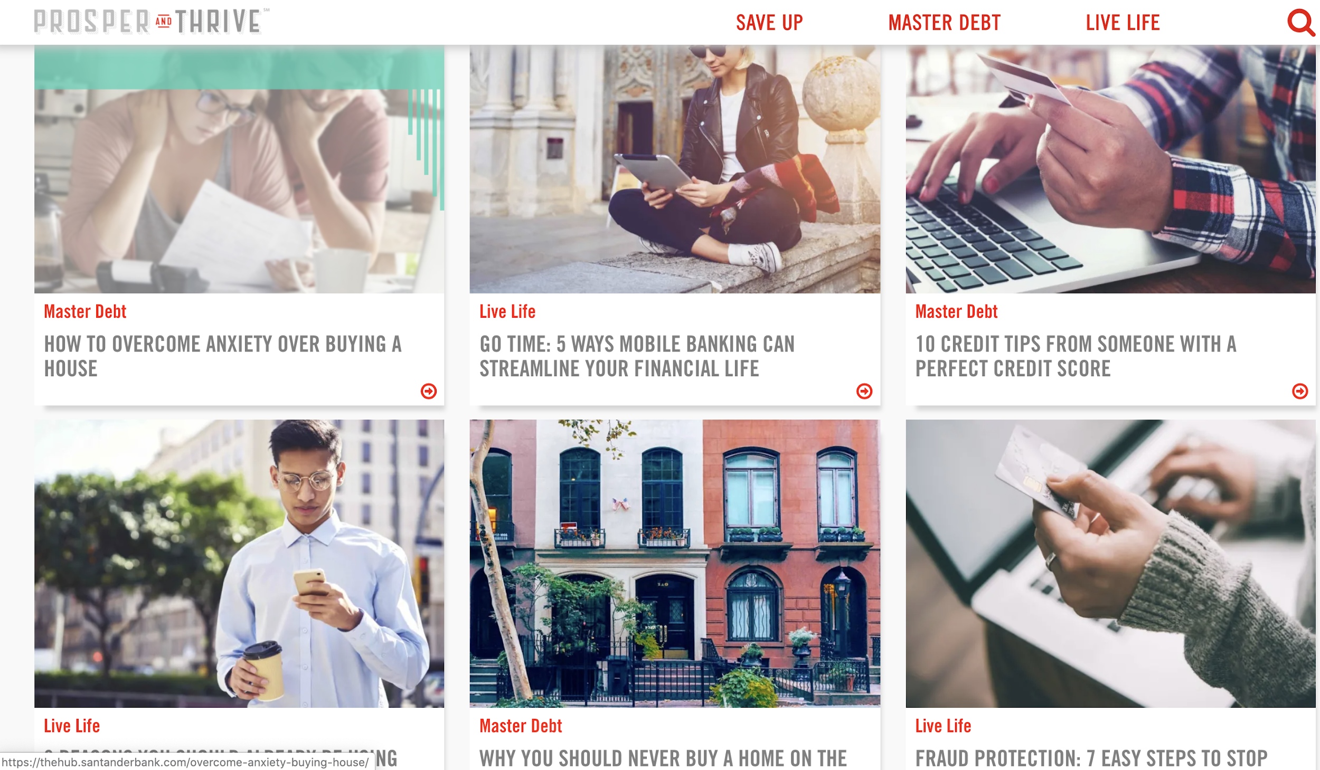
Content and Keywords
Customize It!
Business problem: Santander Bank was having challenges connecting with young adults/millennials.
Solution: After realizing that this population didn’t search for “banking,” it created a blog to answer question about banking and investing.
Notes:
Purpose: Discuss how Santander wanted to connect with young adults/millennials.
TALKING POINTS:
Santander was having issues connecting with young adults. After researching, it found that millennials/young adults don’t actually use the word “banking” when looking for information on finances, but they do search for related topics such as credit tips, wealth building tools, and debt.
In response, Santander created this blog to “answer” questions/queries and get in front of this audience to help them understand the connection.

Slide 71
Paid Search: How It Works
Establish keywords for which you want to appear.
Group keywords by customer stage/intent.
Determine your bid.
Ensure experience is consistent and relevant to the keyword.
Search Intent
Your Ad
Your Website
Notes:
Purpose: Showcase how paid search works.
TALKING POINTS:
Remember that paid search marketing affords businesses the opportunity to advertise within the sponsored listings of a search engine or partner site.
This is how it works.

Slide 72
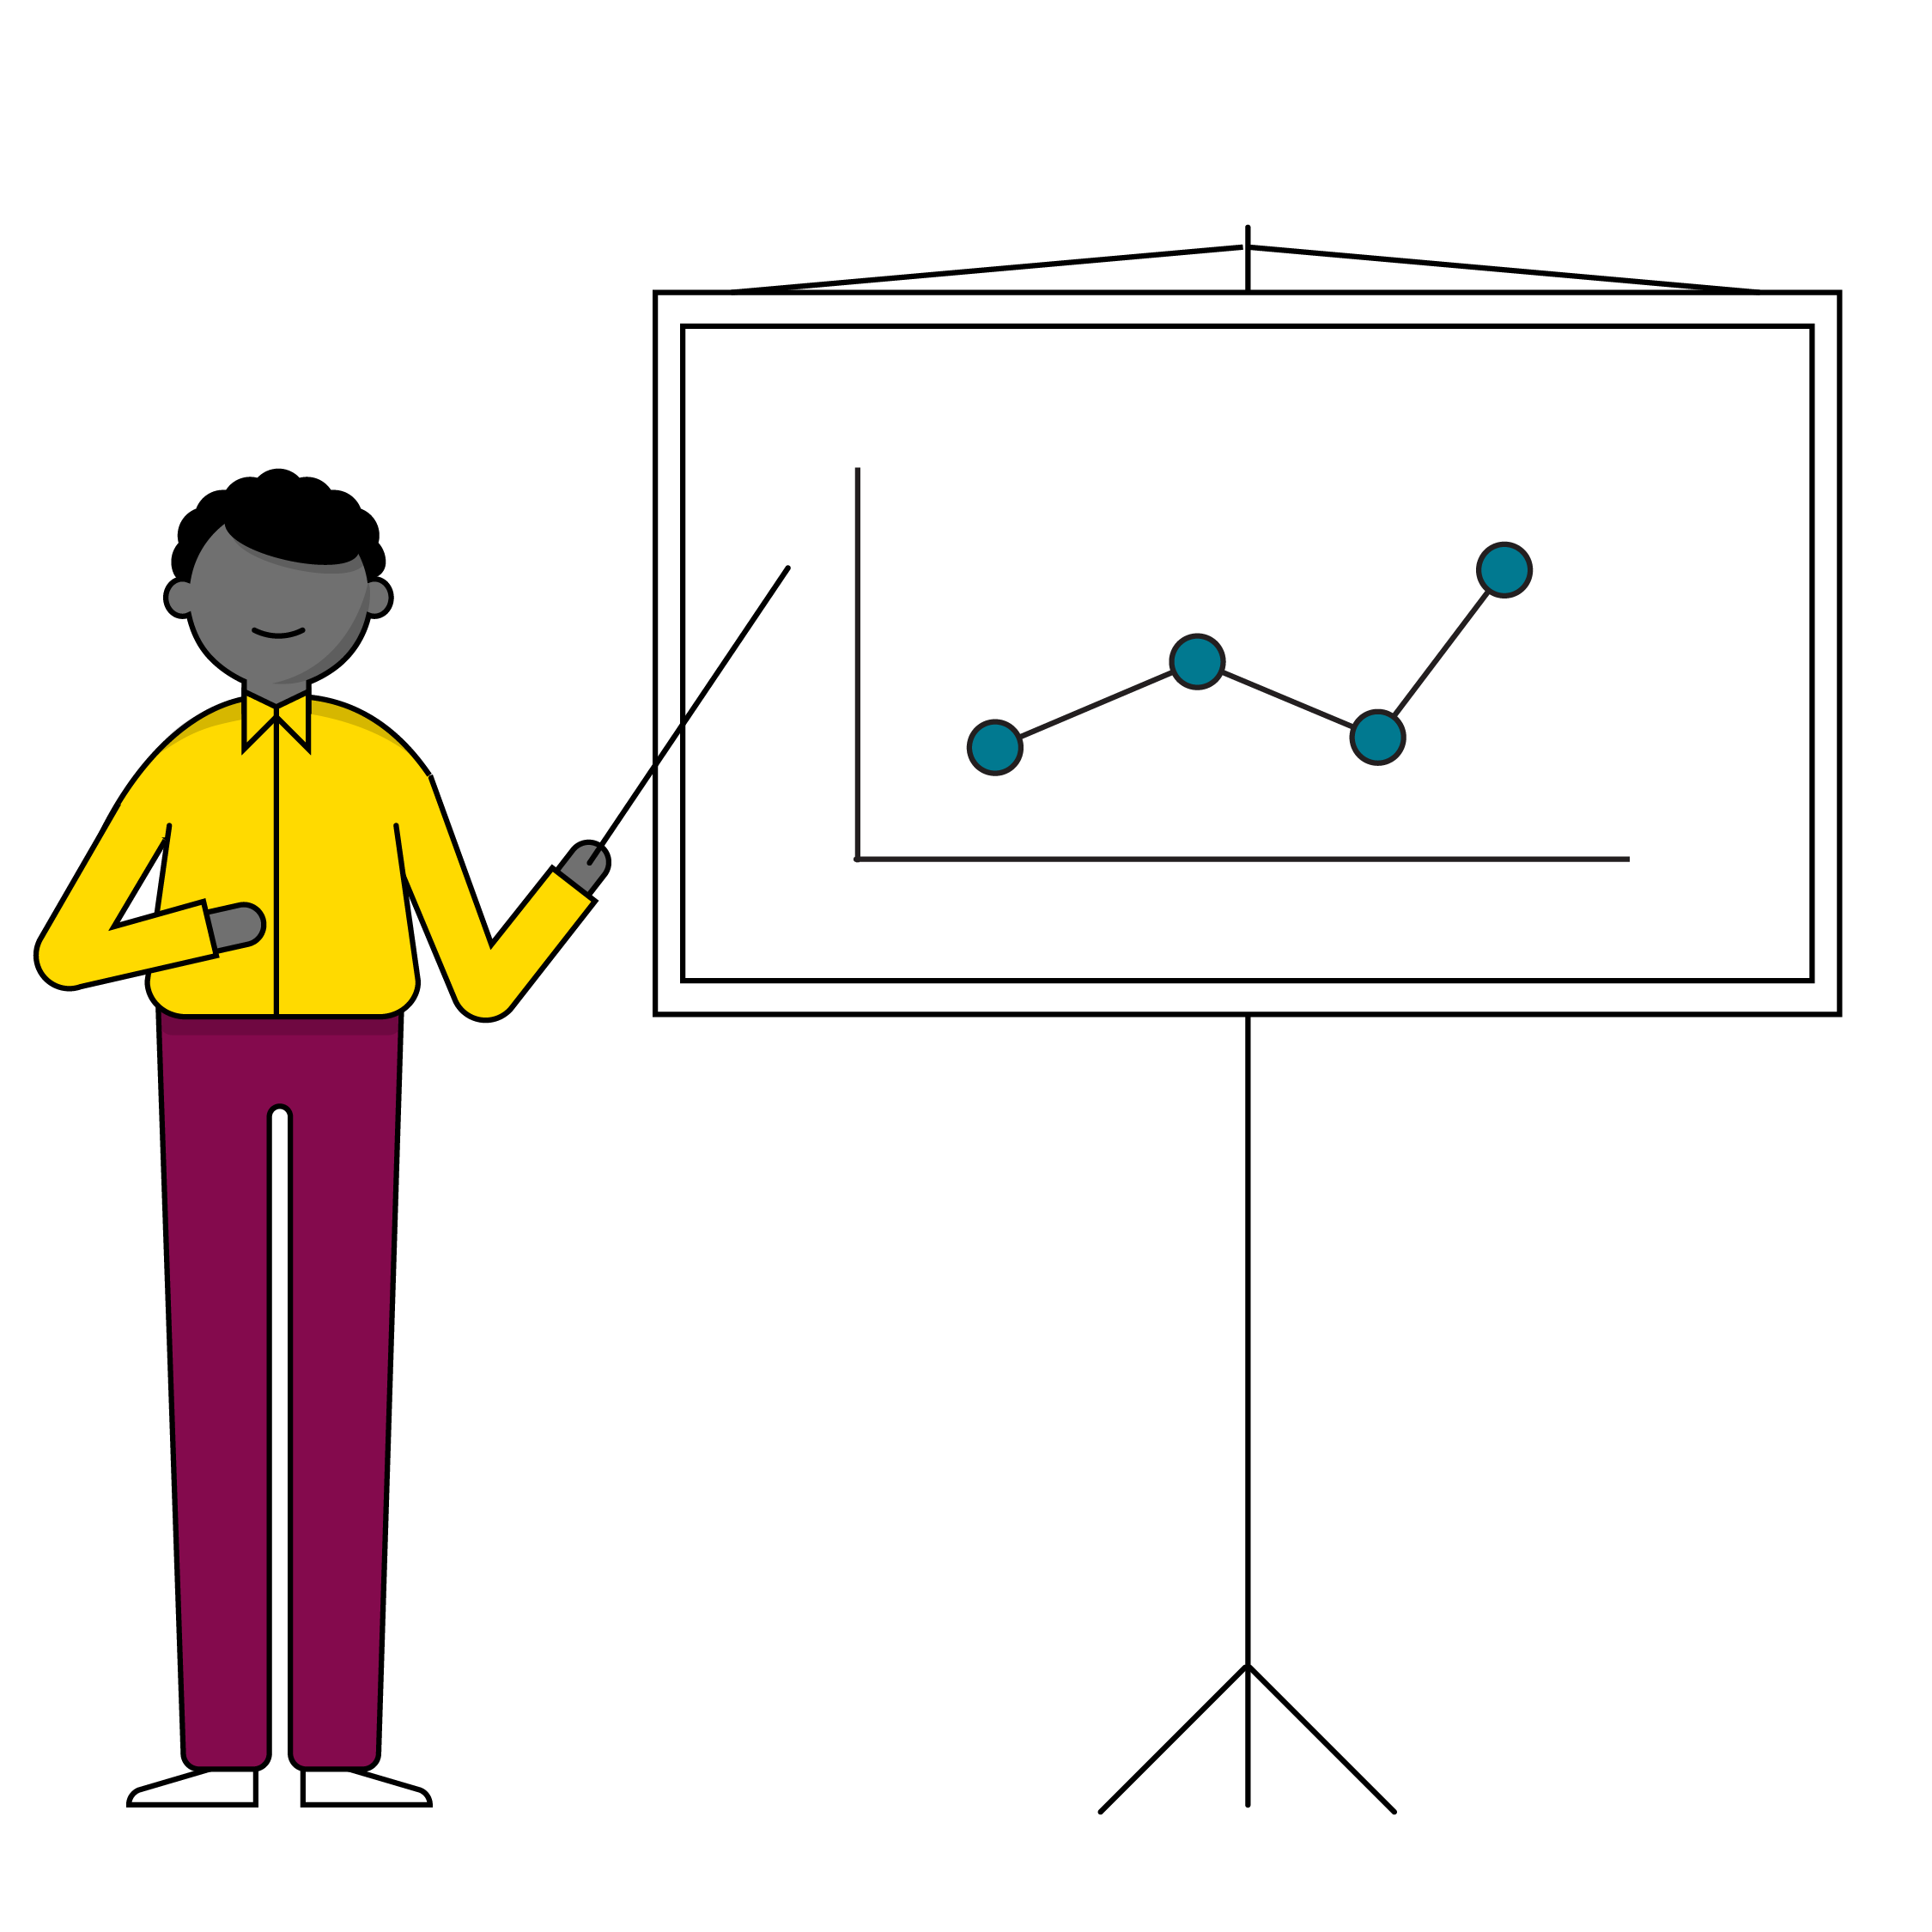
Search Metrics
Organic traffic (and % of total traffic).
SERP CTR.
Behavioral metrics of organic traffic visitors (bounce rate, conversion rate).
Top exit pages of organic traffic visitors.
Ranked keywords (only available via tools like SEMRush).
Notes:
Purpose: Explain the best metrics to track when using paid search.
TALKING POINTS:
Here are a few metrics to keep in mind when using paid search.

Slide 73
Keyword Brainstorm
10 minutes
On your worksheet, list at least 10 keywords relevant to your project, balancing between low, medium, and high intent.
Keep in mind the consumer expectation!
Think about how these words tie into your campaign objective and KPIs.
Be prepared to share your work with the class when you’re done!
Notes:
Purpose: Give students a chance to write down relevant terms for their projects.
TALKING POINTS:
Now that we’ve had a chance to gain a better understanding of SEO, let’s try using what we’ve learned on your individual projects.
For remote classrooms:
Set up breakout rooms for students to work independently but in groups. This mimics the “table” format of an in-person classroom setting.
Screenshot this slide and post it in the Slack channel before opening the rooms.
At the 60-second mark, send a message to all rooms stating: “Start to wrap up your discussions. Rooms will close in one minute!”
Move around from breakout room to breakout room to effectively “walk around the classroom.”
Have students either come off mute to share their responses aloud or simply share them in the chat.

Slide 74
Email
Channels and Design Tactics

Slide 75
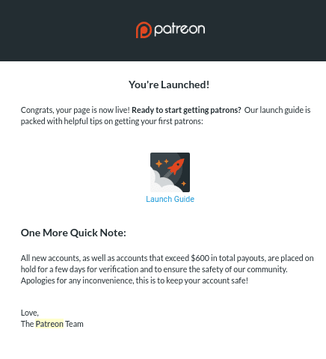
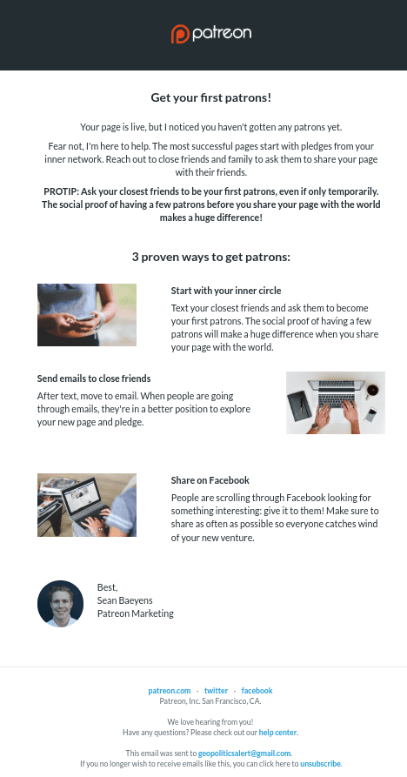
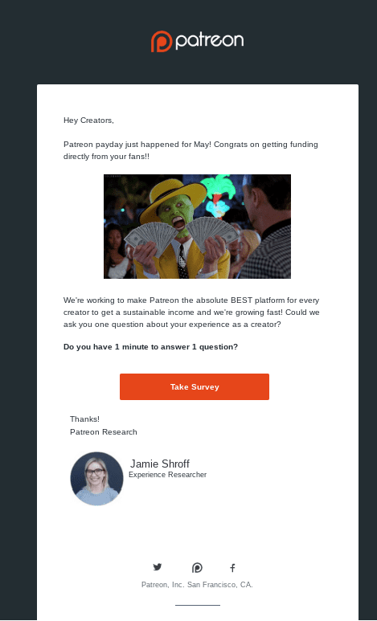
Patreon Marketing Campaign
Customize It!
Business goal: Patreon wants to encourage engagement by educating people about the platform, congratulating new creators on their launch.
Time
Source: Delivra Marketing Case Studies 2018
Notes:
Purpose: Show students how email marketing works.
Source: https://bit.ly/37QCNcu.
TALKING POINTS:
For email, the average open rate is 22%.
Email marketing is rated the No. 1 channel to help drive profits and the preferred method of communication by consumers.
Patreon sends a few welcome emails congratulating the creator on their launch. In these emails, it also explains how to set up a profile.
The website then sends a series of staggered step-by-step emails with tips on how to get your first patron and how to spread the word about your launch. Notice the one-on-one conversational tone.
Later, Patreon uses payday as an opportunity to ask creators to take its survey.

Slide 76
Email: What Customers Do With Your Emails
Purchase something.
YOUR BRAND
Use your product or service.
Take a desired action.
Demonstrate an interest or need.
Not complete a desired action.
Notes:
Purpose: Overview of what customers do with emails from businesses.
TALKING POINTS:
Over the course of a customer’s relationship with your brand, they will do some or all of the following:
Buy something.
Use your product/service.
Tell you what they would like to see from your brand.
Can you think of any brands that you receive emails from on a regular basis? What do you do with these emails?

Slide 77
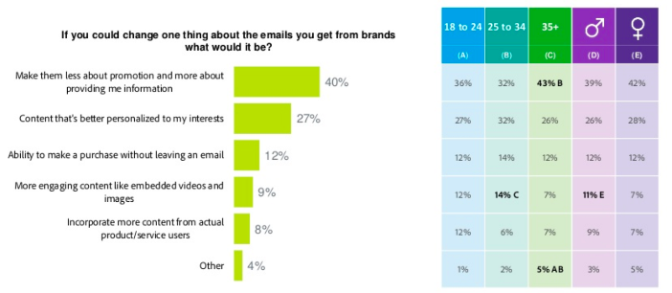
Email: Your Customer’s Email Wishlist
Customize It!
Source: Adobe Email Survey Report
Notes:
Purpose: Provide students with more insight into what consumers are looking for when it comes to email marketing.
TALKING POINTS:
Brands may need to do a fair amount of educating before converting a lead into a customer.
Providing information on the industry and your product itself are common tactics for educating B2B customers. Consider what content you can deliver that will present you as a thought leader in the space. Perhaps some of this content can be repurposed from other channels, such as LinkedIn or your company blog.
For consumers, it may make sense to include information about the product, user reviews, or feature social influencers who are using it.
The main purpose of serving up information to leads is to inspire them to convert into customers or perform an action that you can use as a data point for your next touch.

Slide 78
The Purposes of Email | Part 1
Welcome New Lead
Retargeting Interest
Take Desired Action
An important step on the journey to developing loyal customers.
74.4% of consumers expect a welcome email when they subscribe.
Average open rate is more than 50%.
Also known as “remarketing,” this refers to reaching back out to a customer and can be performed based on behavioral data such as:
Last opened email.
Products previously viewed.
Helpful for driving specific business objectives because the action supports the objective. For example:
The desired action of users adding an article to their playlist supports the objective of “drive user engagement.”
Notes:
Purpose: Introduce the purposes of email marketing.
TALKING POINTS:
Welcome new lead: Thank the new user, deliver on any promotion or product that was promised (e.g., a special offer or download), and suggest the next step.
Retargeting interests: This is also called email remarketing and refers to reaching back out to a customer or lead about a missed opportunity. The classic example is an abandoned cart email with titles like “Did You Forget Something?” or “You’ve Got Great Taste!”
Take desired action: The action should support a business objective as illustrated by the example.

Slide 79
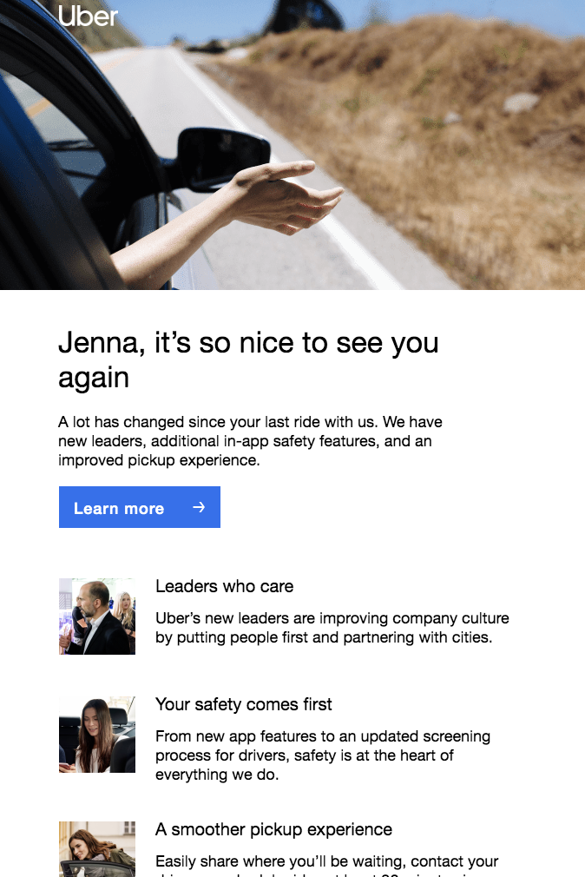
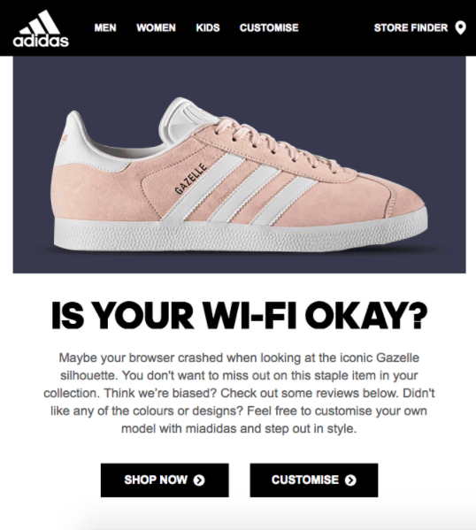
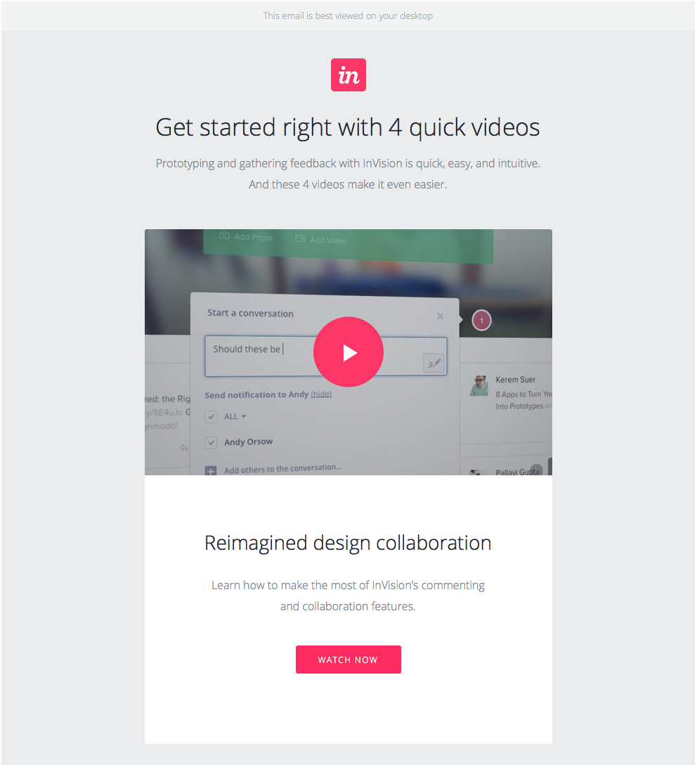
Let’s Take a Look!
Customize It!
1
2
3
Notes:
Purpose: Have students review and match the email image to the purpose that it serves.
TALKING POINTS:
Looking at the examples provided, can you tell which one is used for welcoming new leads, which one is used for retargeting interest, and which one is used for encouraging one to take a desired action?
Answers:
Image 1: Take desired action.
Image 2: Retargeting interest.
Image 3: Welcome new lead.
Customize It!
Feel free to replace the images provided.
For remote classrooms:
Invite students to come off mute or take a screenshot of this slide and drop it in the Slack channel. Ask students to thread their responses.

Slide 80
The Purposes of Email | Part 2
Share Knowledge
Ask for Feedback
Express Appreciation
Consider what content you can deliver that will portray you as a thought leader in your space.
For consumers, it may make sense to:
Include product news.
Provide user reviews.
Feature influencers.
By asking for feedback, you can increase brand favorability in almost a quarter of your audience:
The average response rate for email surveys is 24.8%.
Brands often express appreciation for customer support after purchases or for important milestones such as
Reaching a certain number of followers.
An anniversary.
Be aware that saying thank you by giving a special discount may be trivializing the relationship.
Notes:
Purpose: Introduce the purposes of email marketing.
TALKING POINTS:
Share knowledge: The main purpose of these emails is to inspire leads to convert to customers or get leads to perform an action that you can use as a data point for your next touch.
Providing information on the industry and your product itself is a common tactic for educating B2B customers. Consider what content you can deliver that will present you as a thought leader in the space. Perhaps some of this content can be repurposed from other channels, such as LinkedIn or your company blog.
For consumers, it may make sense to include information about the product, provide user reviews, or feature social influencers who use the product.
Ask for feedback: This also extends the customer experience in a meaningful, interactive way.
Express appreciation: Who doesn’t love a little gratitude now and again? But it’s important to do it consciously, sometimes a heartfelt thank you is plenty.

Slide 81
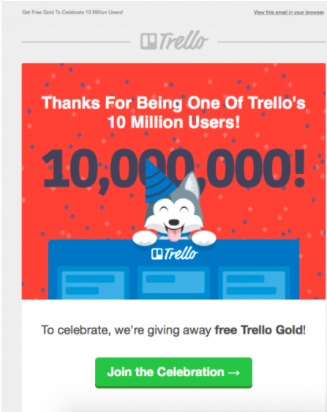

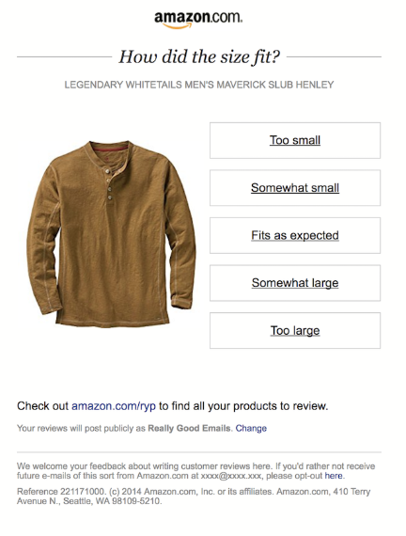
Let’s Take Another Look!
Customize It!
1
2
3
Notes:
Purpose: Have students review and match the email image to the purpose that it serves.
TALKING POINTS:
Looking at the examples provided, can you tell which one serves what purpose?
Answer:
Image 1: Express appreciation.
Image 2: Share knowledge
Image 3: Ask for feedback.
Customize It!
Feel free to replace the images provided.
For remote classrooms:
Invite students to come off mute and share their answers aloud.
Or, take a screenshot of this slide and drop it in the Slack channel, then ask students to thread their responses in the chat.

Slide 82
The Purposes of Email | Part 3
Reengagement
Promotional Email
Transactional
Reengage lapsed customers and rekindle the chemistry with “winback” emails to:
Incentivise them to return.
Confirm that they want to unsubscribe.
Be aware that inactive subscribers on your list could result in your emails being listed as spam.
Make your subscribers feel special by asking their opinion and delivering personalized content, offers, and free stuff they cannot get anywhere else. For example:
News announcements.
Exclusive discount codes.
VIP events invites.
Build your relationship with the customer by:
Personalizing.
Creating a positive brand experience.
Making the service simple, easy, and transparent.
Tip: Infuse the copy with fresh ideas!
Notes:
Purpose: Introduce the purposes of email marketing.
TALKING POINTS:
Reengagement: This is used when engagement has gotten a bit stale and you want to reengage by way of “winbacks.”
Promotional email: Titles of such emails may include “We wanted you to be the first to know” or “You heard it here first.”
Transactional: Just because transactional content can be dry, it doesn’t mean that the copy has to be stale. Infuse it with creative ideas like vibrant brand colors and layout.

Slide 83
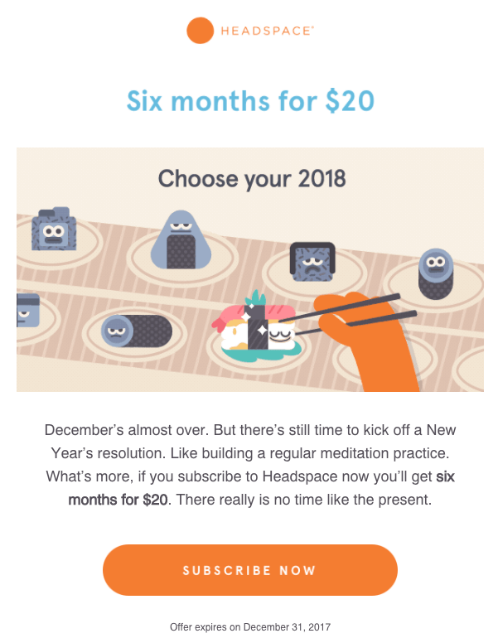
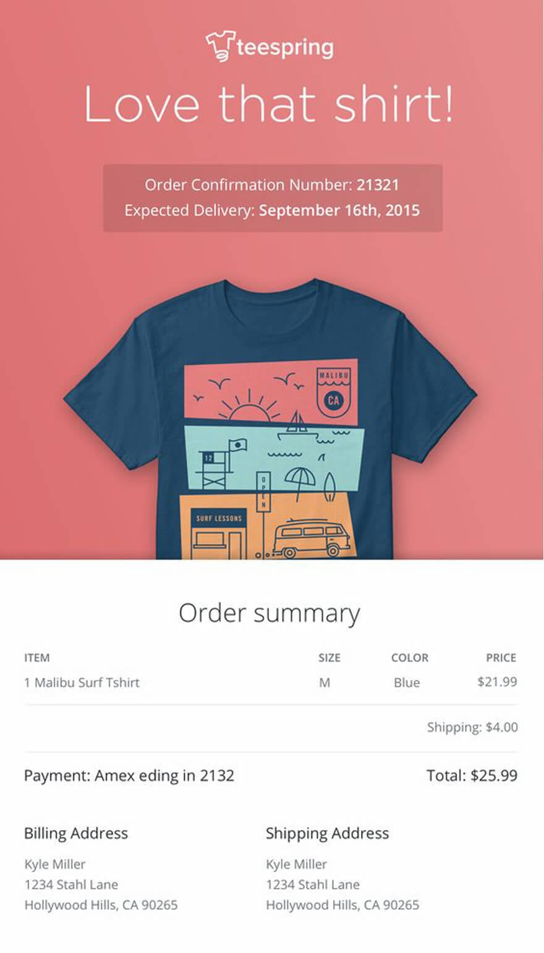
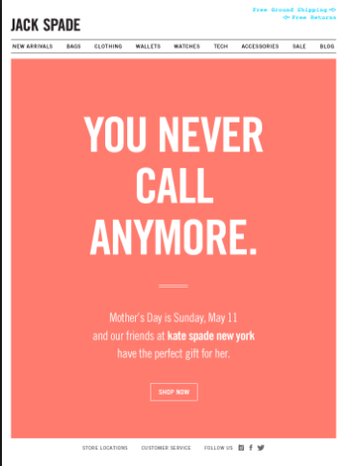
Let’s Take One Last Look!
Customize It!
1
2
3
Notes:
Purpose: Have students review and match the image to the purpose that it serves.
TALKING POINTS:
Looking at the examples provided, can you tell which one serves what purpose?
Answer:
Image 1: Promotional.
Image 2: Transactional.
Image 3: Reengagement.
Customize It!
Feel free to replace the images provided.
For remote classrooms:
Invite students to come off mute and share their answers aloud.
Or, take a screenshot of this slide and drop it in the Slack channel, then ask students to thread their responses in the chat.

Slide 84
Explicit Data vs. Implicit Data
Explicit (Basic)
Implicit (Expert)
Email address
Name
Zip code
Demographic info
Where are they spending most of their time on your site?
What ad channel did they come from?
What actions do (or don’t) they take?
Do they share to social media?
vs.
Notes:
Purpose: Help students understand the spectrum of information one can collect from a customer using email marketing.
TALKING POINTS:
Remember that basic/explicit and expert/implicit is not a hard and fast rule, but it is a trend you can use to help wrap your mind around it.
Depending on how your platforms are integrated, your emails can be as simple as including subscribers’ first names or sending a special birthday email. This is making use of all explicit information.
Things get more complicated when we want to incorporate implicit information into our personalized campaigns. Let’s look at some examples in the next section.

Slide 85
Email Metrics
Delivery Rates | Emails Delivered / Emails Sent | Aim for 100% | What’s causing our delivery rate to be less than 100%? If the delivery rate is sinking over time, how can we clean up our email list? Are we cleaning up our list frequently enough?
Open Rate | Emails Opened / Emails Delivered | ~ 20– 25% | What time of the day has the highest open rates? What should we A/B test? What characteristics can we borrow from emails with the highest open rates? Can we segment our audience more narrowly?
Click Rate | Click-throughs / Emails Delivered | ~ 2–3% | Are our CTAs bold enough? What A/B tests should we run? If our click rate is not improving over time, are we testing new and fresh calls to action?
CT Open Rate | Click-throughs / Emails Opened | N/A | How does the CTOR compare with the general CTR? What A/B tests should we run? How can we improve our click rate for those who open the email?
Notes:
Purpose: Understanding the metrics behind email marketing.
TALKING POINTS:
Now that we’ve had a chance to look at some examples of what email marketing, let’s gain a better understanding of the metrics we should follow to determine whether or not our campaign is successful.
Metrics provide a numerical way for you to measure and monitor how your emails are performing.
Has anyone had experience with these metrics in their work?

Slide 86
Email Metrics (Cont.)
Bounce Rate | Bounced Emails / Emails Delivered | ~ 0.5% | Are we removing hard-bounce email addresses from our list? How are we managing email addresses (individual or domain-level) that repeatedly result in soft bounces?
Unsubscribe Rate | Unsubscribes / Emails Delivered | ~ 0.5– 1% | Are we sending too many emails? Are we adding fresh users to our email list fast enough? Is our content relevant or personalized enough?
Spam Rate | Spam Reports / Emails Delivered | < 0.1% | Did the content read like spam? Are there people on our list who don’t want to be? Where are the email addresses on the list coming from?
Notes:
Purpose: Understanding the metrics behind email marketing.
TALKING POINTS:
Has anyone had experience with these metrics in their work?

Slide 87
Email Drafting
10 minutes
On your worksheet, draft an email to your customers that might help you accomplish your main campaign goal. Consider:
What’s the objective of the email?
To whom would you send the email?
What information/content would you include in the email?
What would you have on the landing page to which you’re sending people? Sketch out what it would look like.
Be prepared to share your work with the class when you’re done!
Notes:
Purpose: Give students a chance to draft an email to their customers for their project.
For remote classrooms:
Set up breakout rooms for students to work independently, but in groups. This mimics the “table” format of an in-person classroom setting.
Screenshot this slide and post it in the Slack channel before opening the rooms.
At the 60-second mark, send a message to all rooms stating: “Start to wrap up your discussions. Rooms will close in one minute!”
Move around from breakout room to breakout room to effectively “walk around the classroom.”
Have students either come off mute and share their responses aloud or share them in the chat.

Slide 88
Social
Channels and Design Tactics

Slide 89




Why Social? By the Numbers
68% of U.S. adults now report that they are Facebook users, and roughly three-quarters of those users access Facebook on a daily basis.
35% of U.S. adults now say they use Instagram, an increase of seven percentage points from 2016.
YouTube is now used by nearly three-quarters of U.S. adults and 94% of 18- to 24-year-olds.
More than 80% of Twitter’s global population is under 50 years old.
Notes:
Purpose: Provide students with data that reflects the importance of social media marketing.
TALKING POINTS:
Social media plays a very important role in today’s society and how businesses cater their brands to consumers.
If you look at the statistics, no matter our age group, we spend a lot of time on these platforms. Something a lot of us have taken note of is that, whether its a pop-up or a sponsored post, it items (clothing, accessories, sneakers) that we may consider purchasing from a brand that we are familiar with.

Slide 90
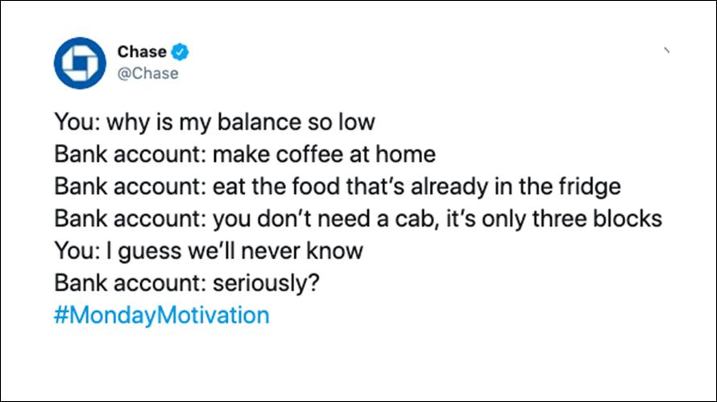
Where’s the Value?
Customize It!
JP Morgan Chase used the #MondayMotivation hashtag to appeal to millennials, encouraging financial responsibility and that they invest in an advisor.
The tweet generated some backlash because it was seen as belittling and condescending.
Source: NBC News
Notes:
Purpose: Provide a real-world example of a brand not providing value.
TALKING POINTS:
The tweet was met with a lot of scrutiny because it was seen as “poor shaming” or belittling the everyday experiences or working class individuals.
What value is this providing to their customers?
Customize it!
Swap out the example for another that violates one of the four universal rules.
Example source: https://www.nbcnews.com/tech/social-media/chase-bank-deletes-monday-motivation-tweet-after-drawing-social-media-n999756.

Slide 91
Social Media Use Cases
Platform | Why people use it? | Marketers use it to…
Facebook | It has two billion users, but you have to pay to play. | Engage in dialogue with followers. Build an online community. Generate leads.
Instagram | It’s where people get inspired. | Tell visual stories to promote branding.
YouTube | It’s where we increasingly turn for TV. | Provide branded entertainment. Answer common questions.
Twitter | It’s where the world’s most famous people talk to each other and the rest of us get to chime in. | Provide customer service, niche targeting, and event-based marketing.
Notes:
Purpose: Provide a high-level overview of use cases for social channels.
TALKING POINTS:
Facebook user expectations: Users enjoy conversational content and a focus on compelling stories that frame them as the hero, not the brand. Ads are welcome if relevant.
Instagram user behavior/expectations: Traditional ads are unwelcome. Visually beautiful content is appreciated.
YouTube user behavior/expectations: Users enjoy watching videos, especially on mobile. It’s their source for news, entertainment, inspiration, and learning.
Twitter user behavior/expectations: Responses are expected almost immediately, and authenticity is valued and rewarded with interaction.

Slide 92

The Social Sweet Spot
Brand Message
Customer Needs, Values, and Preferences
Notes:
TALKING POINTS:
In general, brands need to find the interaction of their brand message and their consumers needs.

Slide 93
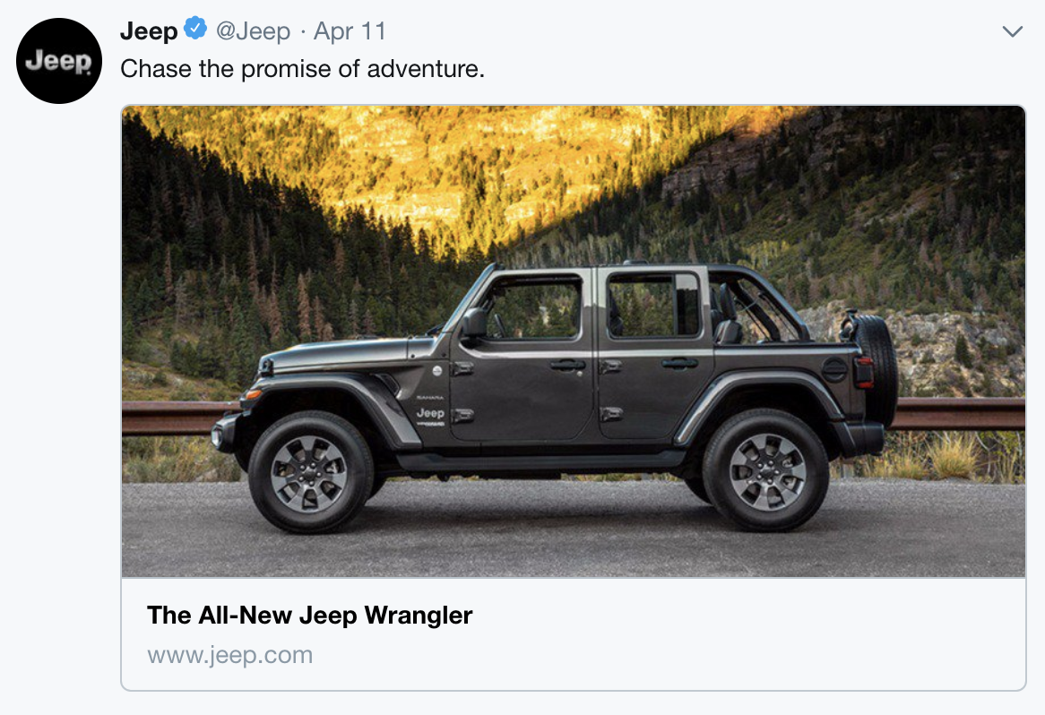
Big Biz in Social
Customize It!
Take a look at the Jeep’s social campaign below. How does it do in terms of meeting the social sweet spot? Is it on point or otherwise? Why?
Brand Message
Customer Needs, Values, and Preferences
Notes:
Purpose: Give students a chance to articulate how both the brand message and customer needs are addressed.
TEACHING TIPS:
Additional examples can be found at the end of this deck.
For remote classrooms:
Have students come off of mute and share their responses aloud.
Customize it!
Replace the example with another campaign that demonstrates how a company finds the intersection of their brand message and their consumers’ needs.

Slide 94
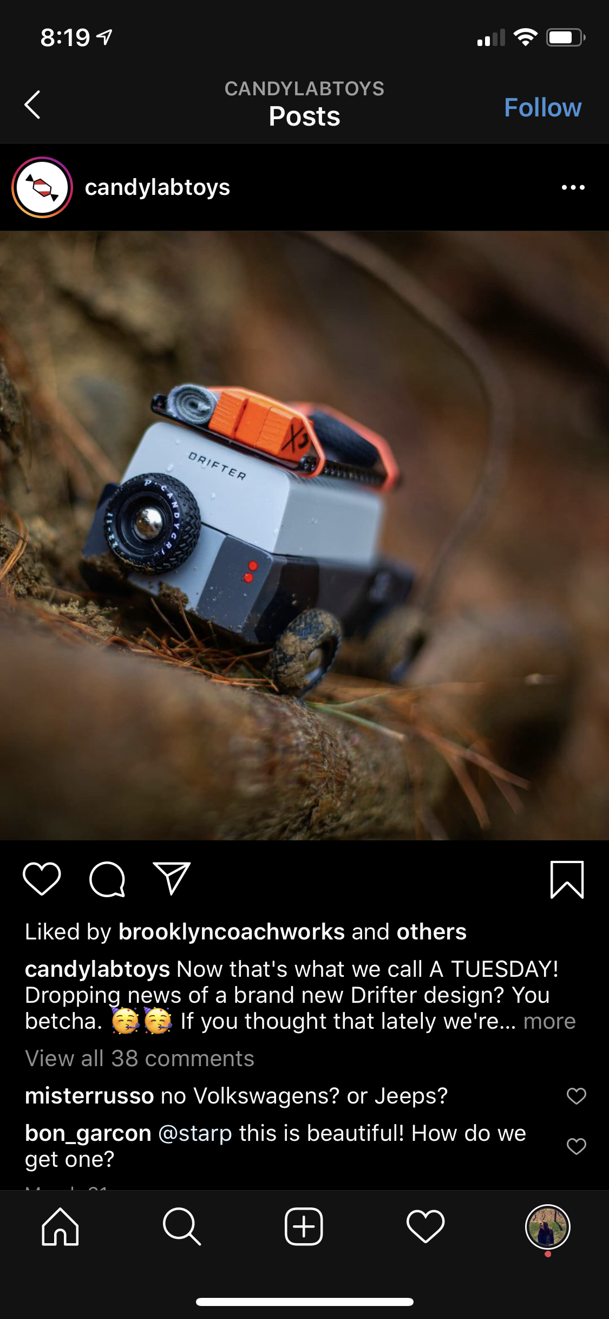
Small Biz in Social
Customize It!
Take a look at the following social campaign for Candylab Toys. How does it do in terms of meeting the social sweet spot? Is it on point or otherwise? Why?
Brand Message
Customer Needs, Values, and Preferences
Notes:
Purpose: Give students a chance to articulate how both the brand message and customer needs are addressed.
TEACHING TIPS:
Additional examples can be found at the end of this deck.
Customize it!
Replace this example with another campaign that demonstrates how a company finds the intersection of their brand message and their consumers’ needs.
For remote classrooms:
Have students come off of mute and share their responses aloud.

Slide 95
Social Metrics
Engagement Rates | Total Engagement
CTR | Clicks / Reach
View Through Rates | Completed Video Views / Reach
Mentions | Total Engagement/ Reach
Reach | Number of Individuals Who Saw the Content
Notes:
Purpose: Overview of significant metrics to track for social media campaigns.
TALKING POINTS:
Unfortunately, some metrics are defined differently by platform. Generally speaking, as it relates to engagement, you want to separate out platform-specific engagements (e.g., likes, comments, and saves) from clicks or video views, as they speak to different engagement and intent by the consumer.
Note that reach differs from impressions on social and oftentimes is a more practical way to look at your content success. Impressions are defined as the amount of times your content was served on a social feed versus the number of times it was actually viewed by an individual. Reach is a more accurate way to understand how many people saw the content.
Business metrics from website visitors sourced from social marketing are important to understand (e.g., bounce rate from social visitors, conversion rate from social visitors, total revenue from social visitors, etc.).

Slide 96
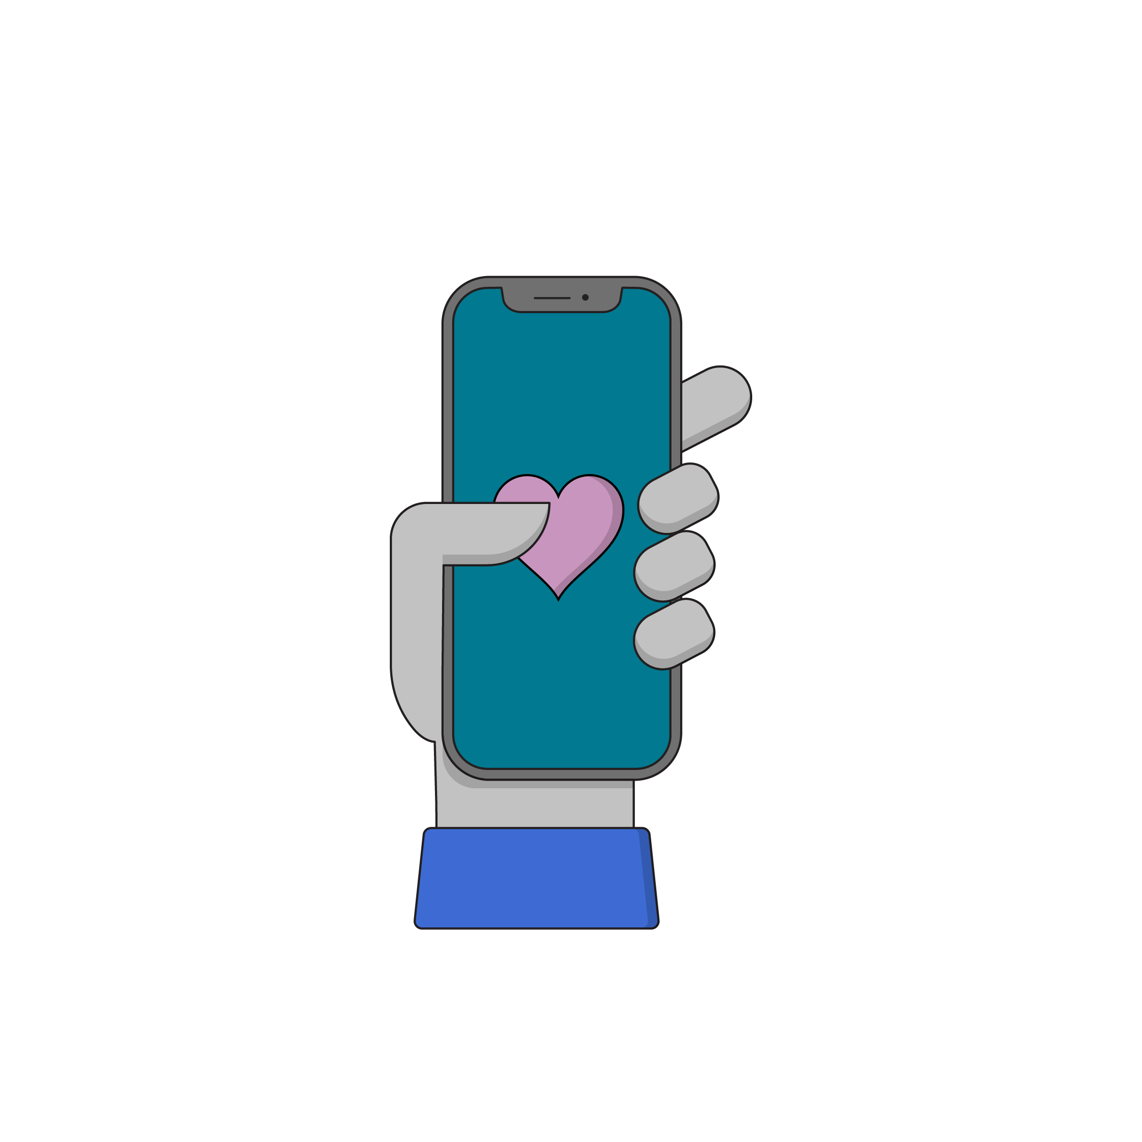
Brainstorm Two Social Media Posts
10 minutes
On your campaign worksheet:
Choose two platforms and create a social post for each. Explain why you chose each platform.
Explain the purpose of the post — what is the one action you want the viewer to take? (Hint: Refer back to your campaign goal.)
Point out how the post provides value or connection to the customer.
What type of media will you use and what is the general copy/message?
Be prepared to share your work with the class!
Notes:
Purpose: Give students a chance to create a social media post for their projects.
For remote classrooms:
Set up breakout rooms for students to work independently, but in groups. This mimics the “table” format of an in-person classroom setting.
Screenshot this slide and post it in the Slack channel before opening the rooms.
At the 60-second mark, send a message to all rooms stating: “Start to wrap up your discussions. Rooms will close in one minute!”
Move around from breakout room to breakout room to effectively “walk around the classroom.”
Have students either come off mute to share their responses aloud or share their responses in the chat.

Slide 97
A Quick Touch on Landing Pages
Channels and Design Tactics

Slide 98
Without a landing page, design tactics are meaningless.
Notes:
Purpose: Introduce the importance of landing pages.
TALKING POINTS:
The social post that you brainstormed and the email you drafted have to direct your customer somewhere!
What’s their purpose? To encourage people to buy something? To get them to sign up for something? Etc.
Landing pages take your customers exactly where you want them to go (e.g., to the product description page or “sign-up” form).

Slide 99
Landing Pages vs. Home Pages
 | Homepage | Landing Page
Objective | Direct visitor to relevant content. | Deliver requested content.
Visitor Intent | Broad range. | Specific.
Traffic Sources | Varied. | Specific campaign.
Navigation | Full range of options. | None (or minimal).
Content | Overall business category and positioning copy. | Specific to benefits of the desired action.
Desired Action | Draw visitors deeper into the website. | Click a single call to action.
Notes:
Purpose: Explain the difference between landing pages and home pages.
TALKING POINTS:
It’s a common misconception that home pages and landing pages are one and the same.
Here’s a breakdown of what we’re looking for when differentiating between home pages and landing pages.

Slide 100
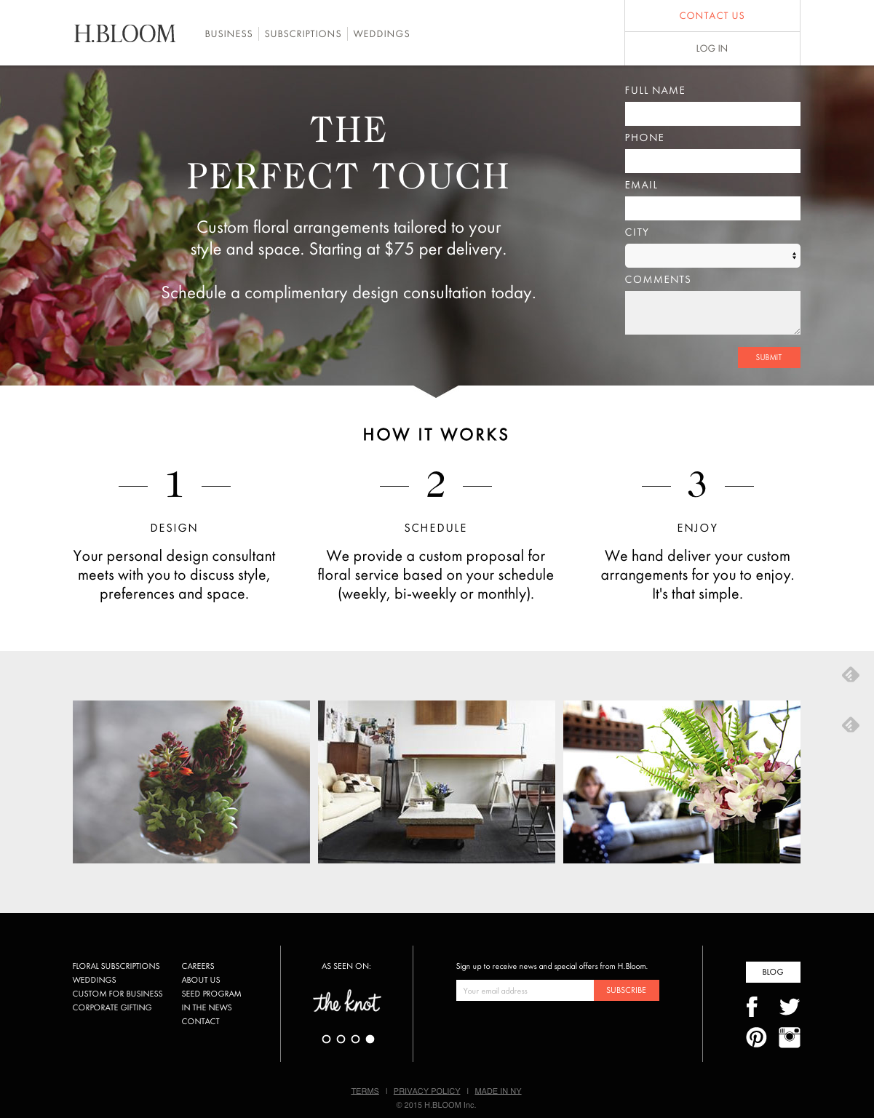
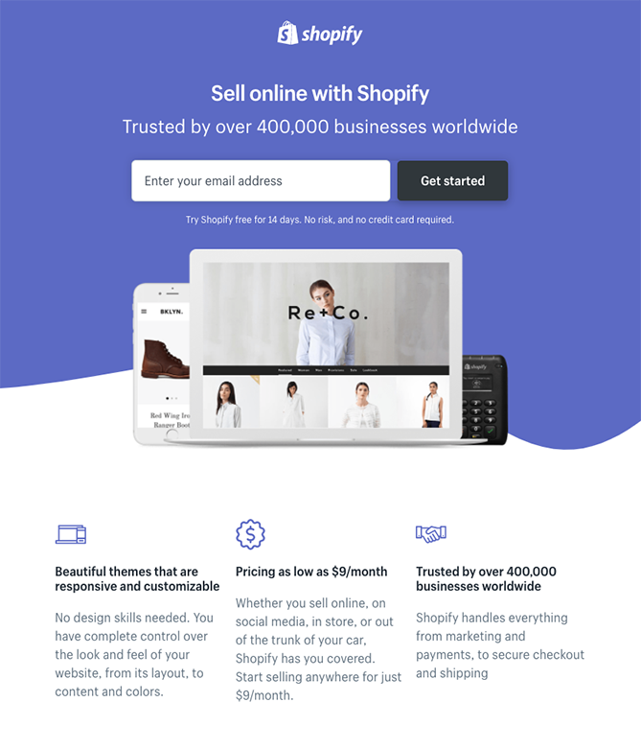
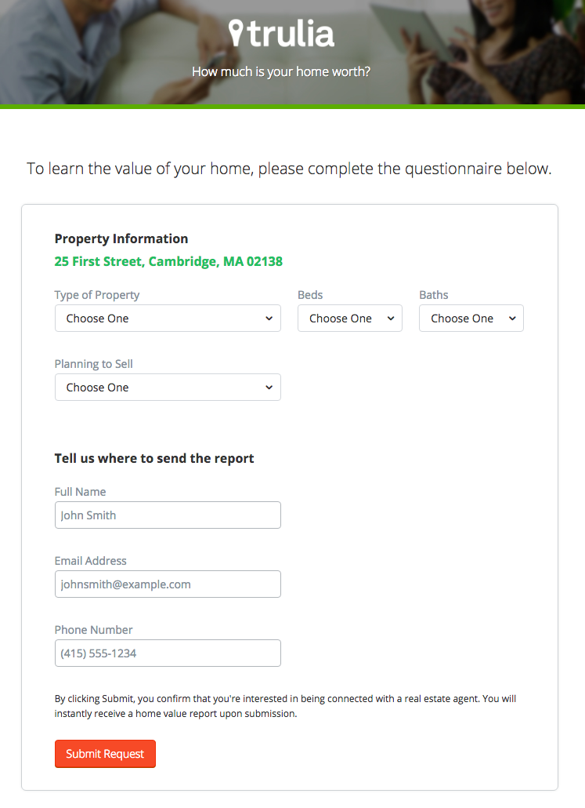
Let’s Take a Look
1
2
3
Notes:
Purpose: Provide visual examples of good landing pages.
TALKING POINTS:
What are some things that you notice about these landing pages?
Avoid visual clutter.
Make it simple to read/understand.
Headline.
Subhead.
Visual.
Fill in information.
Two steps could make it more worthwhile (e.g., Trulia).
Short exercise: Consider what you might add to your own landing page for your project.

Slide 101
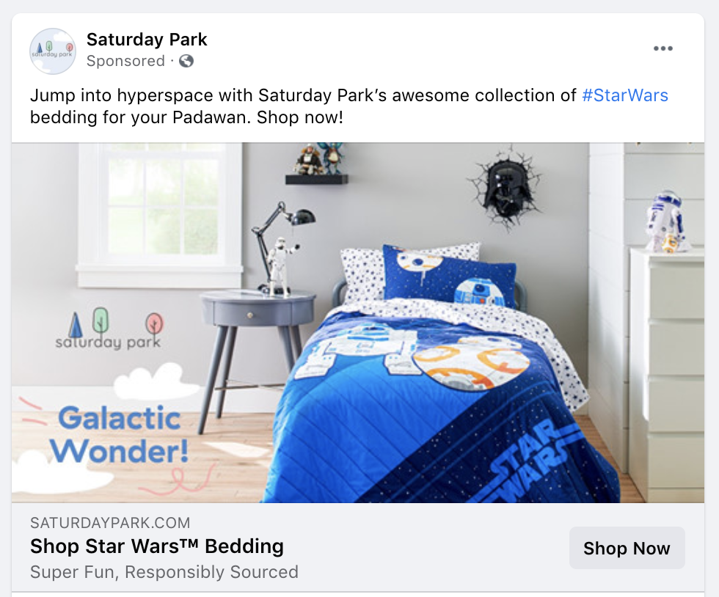

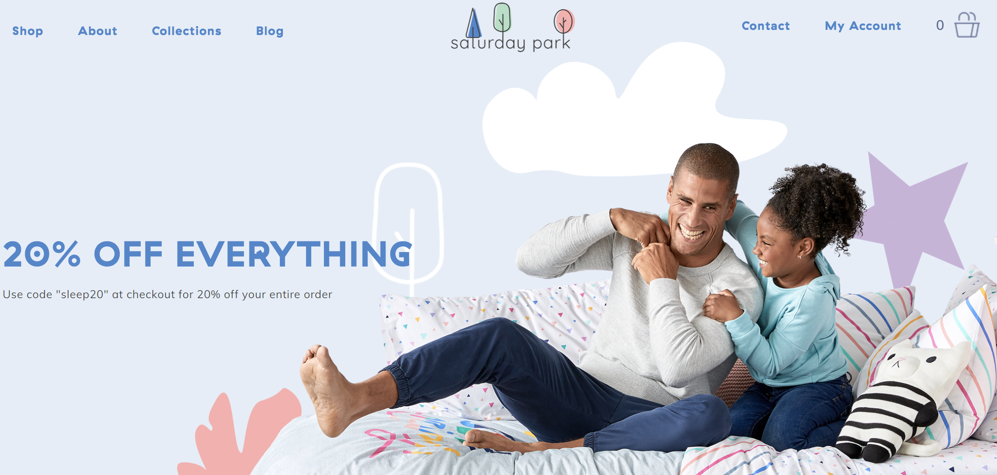
Guiding Principles of Landing Pages
Considerations:
Mobile experience.
First impressions count (i.e., be relevant).
Distinguish how the platform supports different goals.
Notes:
Purpose: Discuss best practices for putting together a landing page.
TALKING POINTS:
Here are a few things to keep in mind when thinking about creating a landing page.

Slide 102
Optimization
Digital Marketing Bootcamp
Objective-First Marketing
The ABCs of KPIs
Channels and
Design Tactics
Optimization
Notes:
Duration: 45 minutes

Slide 103
Where We’re Going
Select an element of a campaign to test and write a hypothesis for that test.
Notes:
Purpose: Point out the learning objectives (from the beginning of the program) that we’ll be covering in the following section.

Slide 104
Where Are We?
Set
Objectives
Define
KPIs
Design
Tactics
Execute Campaign
Measure Outcomes
Optimize
Results
Planning
Execution
Notes:
Purpose: Introduce where we are in the framework. Acknowledge that we’re jumping to “Optimize results.”
TALKING POINTS:
We unfortunately have a limited amount of time together, so we can’t execute and measure the outcomes of the campaigns we’re planning.
We can, however, discuss what it means to optimize a campaign.
However, it’s important to note that, in the real world, you cannot optimize without accurate the collection, measurement, and analysis of results.

Slide 105
Optimizing in the Framework
Set
Objectives
Define
KPIs
Design
Tactics
Execute Campaign
Measure Outcomes
Optimize
Results
Launch
Planning
Change
Execution
Collect
Review
Notes:
Purpose: Point out the stage at which we run experiments to optimize.
TALKING POINTS:
Recall that the framework can be broken in half — the planning half and the execution half.
Once we collect the results from a campaign, we can review what happened, make a change in an effort to optimize, and launch again. This is the optimization cycle!

Slide 106
Optimization: Making a program/campaign/ tactic as efficient as possible by running small experiments.
Notes:
Purpose: Level set on the definition of optimization.
TALKING POINTS:
Optimizing in this context means “maximizing the behavior or action you want from customers.”
At its heart, optimization is about data and the insights that the data provides. How can you increase or decrease spend, evaluate channel performance, set up KPIs, execute a media buy, or onboard a new vendor without excellent data insights?
We can make optimization easy by running small experiments to help us learn and improve continuously.
It’s important to be able to analyze your data, figure out what’s going on, and make a recommendation to improve.
Instead of making major sea changes with those improvements, use the experimenter’s framework (which we’ll cover in this section) to strategically change and test specific components.

Slide 107
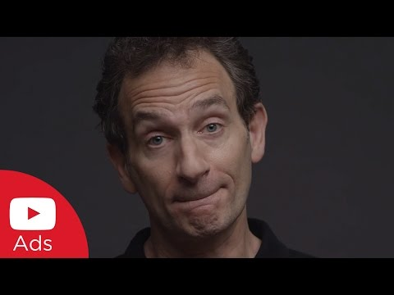
‹#› | © 2021 General Assembly
Notes:
Purpose: Share an example of experimentation in action.
TALKING POINTS:
Let’s look at Mountain Dew and its agency-tested ad format assumptions. It created a mobile video spot that was longer.
The focus here is more on adopting a culture of experimentation and on the need to experiment in marketing specifically, not as an organization as a whole.
TEACHING TIPS:
If needed, clarify some of the jargon in this video while it is playing (e.g., “Take our 30 and put it on TrueView” vs. “Take our 30-second TV commercial and put it on YouTube as an ad”).
Source: https://www.youtube.com/watch?v=6HHgzEGwil4.

Slide 108
Video Debrief
What did they test? Why?
What did they learn?
Notes:
Purpose: Prompt a discussion about the test.
TALKING POINTS:
What did they test? Why?
What did they learn from their test?
TEACHING TIPS:
Main takeaway: Mountain Dew benefited from testing the theory that “everything on mobile has to be quick.” The theory proved to be incorrect!
For remote classrooms:
Have students come off of mute and share their responses aloud.

Slide 109
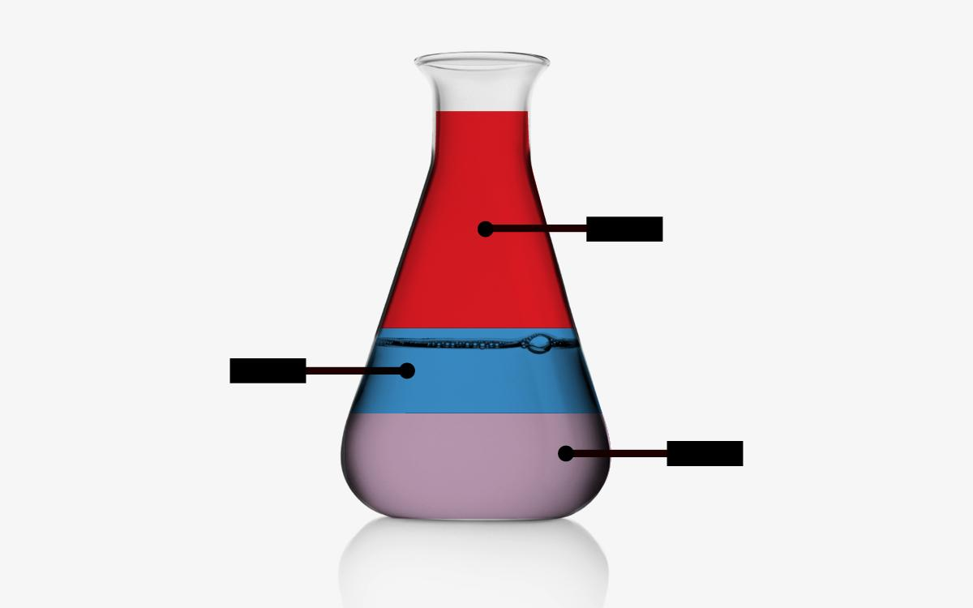
Set Up a Test
A testing hypothesis:
We believe that changing [ X ] into [ Y ] will [ increase/decrease ] [ KPI ].
This change will help us achieve [ objective ] because [ information supporting the change ].
Thing to test
KPI
Objective
Notes:
Purpose: Explain how to frame a hypothesis for an experiment.
TALKING POINTS:
This hypothesis is pretty rigid — in reality, you probably won’t have something this formal, and that’s fine!
The key thing here is to identify an objective, select a KPI to ensure you meet that objective, and determine what it is you’ll be testing.

Slide 110
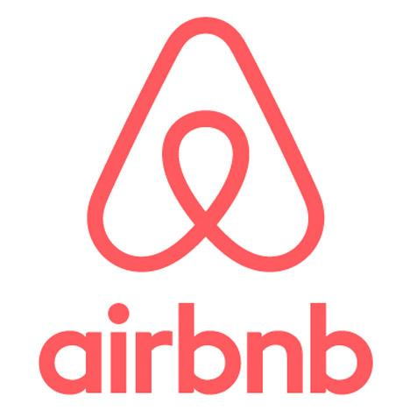
A Testing Hypothesis for Airbnb
We believe that changing non-professional photos of listings into professional photos of listings will increase the number of property bookings.
This change will help us achieve better retention of property hosts because higher-quality photography will attract more customers and persuade those customers to book their listings.
Notes:
Purpose: Walk through a real example of the testing hypothesis.
TALKING POINTS:
The KPI that Airbnb wanted to improve upon was the number of nights a property was rented. Notice that this is more central to its business than simply measuring revenue (which is the ultimate objective to which the initiative ties). Airbnb does well if the site’s homeowners do well. Thus, for the company to succeed, it needs listed properties to be rented often so that the homeowners will stick around.
The company conducted an experiment to find out if taking professional photographs of the listings would lead to an increase in property bookings.
Airbnb sent professional photographers to take pictures of certain properties, had the homeowners use those photos in their listings, and then tracked how many nights those properties were booked. It then compared those properties with properties that had not been professionally photographed.
While this may seem obvious — that improved photos will lead to better listings and higher rentals — testing and collecting hard data is what a data-driven marketing approach is all about. It’s more disciplined, professional, and structured, and it enables you to make fact-based decisions instead of relying on intuition and assumptions.
The results showed that the properties with professional photography had 2–3 times more bookings!

Slide 111
Pulling the Right Levers
Social
Search
Email
Audience targeting
Type of media (image vs. video, etc.)
Content of media (real-life image vs. graphic, etc.)
Copy
CTA
Audience targeting
Keywords
Creative unit (display)
Copy and CTA (text)
Segment
Subject line
Content
CTA
Time sent
Notes:
Purpose: Explain the different “levers” that can be pulled to optimize campaigns on different channels.
TALKING POINTS:
On any given platform, there are certain “levers” that we can pull to optimize a tactic — from creative, to targeting, and more.
The levers that you’ll want to pull depend on the goal of the test and what it is you’re ultimately trying to achieve.

Slide 112
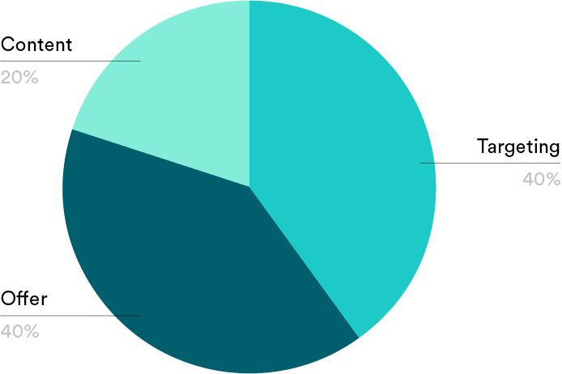
What Do I Test?
Content
What can we test to have the biggest impact on our KPI?
20%
Targeting
40%
Offer
40%
Notes:
Purpose: Identify what components of a marketing tactic can or should be tested.
TALKING POINTS:
The real question here is, “What impacts customer behavior?”
There are a few key variables that are likely to increase your ad’s efficiency. Here’s a handy framework you can use to decide what variable to change: the 40-40-20 rule.
The rule says that 40% of the success of a campaign can be attributed to targeting (i.e., the audience), 40% can be attributed to the offer (i.e., what’s being promoted and how it’s worded), and 20% can be attributed to content (i.e., the visual elements).
Given this rule, your testing efforts should first focus on adjusting a campaign’s target as well as its offer if you want to have maximum impact. You can also test visual elements — many marketers focus on these first because they’re the easiest to see. However, you’ll have less of an effect.

Slide 113

What to Test?
KPI: +% social shares (average share rate is 300 per post)
Results: 5,000 likes 250 shares 3,000 comments
What should we test?
Notes:
Purpose: Look at a real example and its data points in order to better understand how to choose what to test.
TALKING POINTS:
This was a sponsored Facebook post.
TEACHING TIPS:
Ask: Based on these results, what should we test in order to optimize the campaign?
Possible answers:
Include an offer/incentive to increase shareability.
The engagement of the creative: Is the post relevant to the user, not only from a personal but also a cultural perspective? (Think of Slim Jim tapping into the meme culture so successfully.) Does it stand out from the feed, not only to stop the user’s thumb but also to prompt them to share?
For remote classrooms:
Have students unmute themselves to share their responses aloud with the group or have them share via text in the chat.

Slide 114
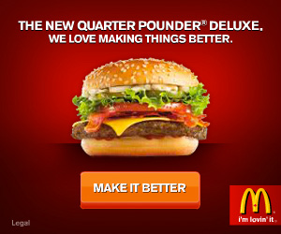
What to Test? (Cont.)
KPI: CTR (average CTR of a digital banner is 3,000)
Results: 6,000 clicks 80% left before completing desired action (bounce rate) $5 CPC
What should we test?
Notes:
Purpose: Look at a real example and its data points in order to better understand testing decisions.
TALKING POINTS:
This was a banner ad.
TEACHING TIPS:
Ask: Based on these results, what should we test in order to optimize the campaign?
Possible answers:
Where is the ad driving people that’s causing them to bounce? We could test the destination and attempt to make that destination connect more effectively with the ad. The ad is clearly meeting its KPI, but it’s resulting in a very expensive, negative user experience.
If we decide to test the creative, we should consider testing the CTA copy.
For remote classrooms:
Have students unmute themselves and share their responses aloud with the group, or have them share responses via text in the chat.

Slide 115
Types of Tests
A/B Testing
Multivariate Testing
Notes:
Purpose: Discuss the major differences between A/B and multivariate testing and use cases for each.
TEACHING TIPS:
Add any other best practices or key differences between the two test types that you have in mind.
A/B tests:
Pick a single variable to change.
Create two or more versions of that variable and change nothing else.
Easier and faster than multivariate testing
Multivariate test:
Create two or more versions of each variable.
The results can be more difficult to interpret than an A/B test but are also more impactful.

Slide 116
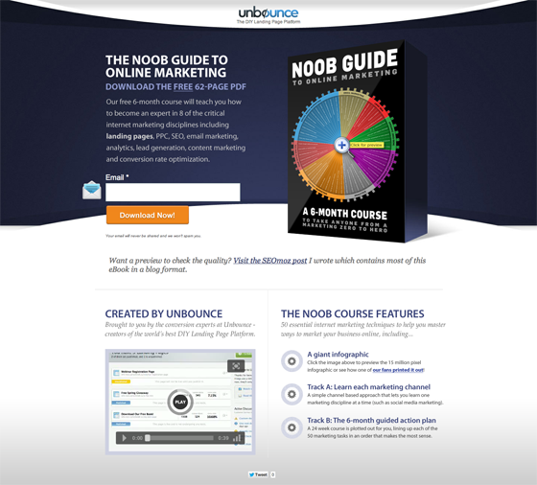
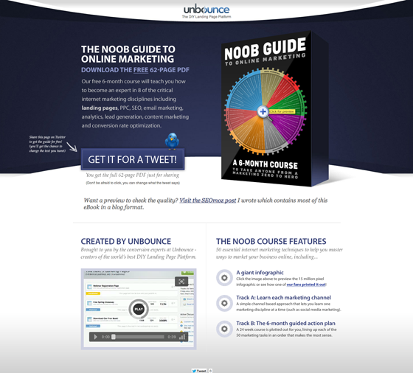
Unbounce and A/B Testing
Customize It!
Notes:
Purpose: Provide an example of A/B testing in action.
TALKING POINTS:
On most landing pages, marketers typically ask users for an email address to deliver their content offers.
However, Unbounce decided to test whether customers would prefer to give an email address or simply tweet about a product.
Both options have pros and cons for the company. Asking for an email address means your company can build a list of potential prospects, while asking people to tweet can build viral momentum and increase social exposure.
The first landing page in this A/B test asked users to give their email address in exchange for an eBook.
The second landing page asked users to send a tweet in exchange for the eBook.
Overall, people far preferred providing an email address. In the end, the email landing page had a 24% conversion lift.
Source: https://blog.hubspot.com/marketing/a-b-testing-experiments-examples.
Customize it!
Replace this real case with another example that demonstrates an A/B test, what was tested, and the results of that test.

Slide 117

Top A/B Testing Tips
Select one KPI toward which to optimize.
Aim for 7–14 days of data collection.
Change one thing at a time.
Check for scale.
Document everything.
Notes:
Purpose: Review some final tips and tricks for testing.
TALKING POINTS:
Pick one (and only one) KPI toward which to optimize.
Aim for 7–14 days of data collection in order to collect sufficient data to inform any decision-making.
Change one thing at a time. Yes, we know that we talked about multivariate testing, but start with A/B testing, changing just one thing at a time.
Check for scale. Do you have enough spend/scale to get the volume of data you need in order to make the test valid?
Document everything.

Slide 118
Design an Experiment
Activity + Debrief Guide
Activity
In this exercise, students will design an experiment for their campaign.
While they won’t have data to inform how the test is designed, they can work through the testing hypothesis and prioritizing elements of the aspect they’ve chosen to test. Students should write out the testing hypothesis on a flipchart.
Give students 10 minutes to write out their hypothesis.
Debrief
Take 5 minutes for the debrief.
Ask for a few volunteers to share their test hypothesis. Lead a brief discussion with the class to share any common or notable findings on the plans and experiments.

Slide 119
Design an Experiment
8 minutes
Campaign Plan Worksheet
Return to your campaign plan.
Choose one element to change and design a test around it. Be prepared to defend why you chose that element.
Complete the testing hypothesis for the tactic you chose to experiment.
Be prepared to share your work with the class when you’re done!
We believe that changing [ X ] into [ Y ] will [ increase/decrease ] [ KPI ].
This change will help us achieve [ objective ] because [ information supporting the change ].
Notes:
Purpose: Walk through how to test an actual marketing tactic.
TEACHING TIPS:
Refer to previous hidden slide for instructions.
For remote classrooms:
Set up individual breakout rooms for students to work together in small groups (like at tables in person). Screenshot this slide and post it in the Slack channel before opening the rooms.
At the 60-second mark, send a message to all rooms stating: “Start to wrap up your discussions. Rooms will close in one minute!”
Move around from breakout room to breakout room to effectively “walk around the classroom.”
Have students either take themselves off mute and share their responses aloud or share them in the chat.

Slide 120
Bringing It All Together!
15 minutes
Now that we have all of the pieces we need for our marketing campaign, let’s bring this all together. It doesn't matter if it's incomplete, just share what you have. Let's collaborate and get inspired!
Share out your objective and KPIs.
Share out your design tactics.
Share out your proposed hypothesis.
Be prepared to share your work with the class as a group when you’re done!
Notes:
Purpose: Give students a chance to share the work they’ve accomplished throughout the day.

Slide 121
Bring It Home
Digital Marketing Bootcamp

Slide 122

In the Past, Digital Marketing Had Just One Seat at the Table
The digital person
Notes:
Purpose: Emphasize the importance of digital marketing.
TALKING POINTS:
In the past, digital marketing was seen as an afterthought and digital marketers a side team. Some organizations still operate in that way; a digital person or team acts as an “add-on” to the overall strategy of the “traditional” marketers. That, however, is becoming increasingly rare, and you wouldn’t see that in any digitally native organization.
In the past, the “digital” team would take up just one seat at the table, if they got a seat at all.

Slide 123
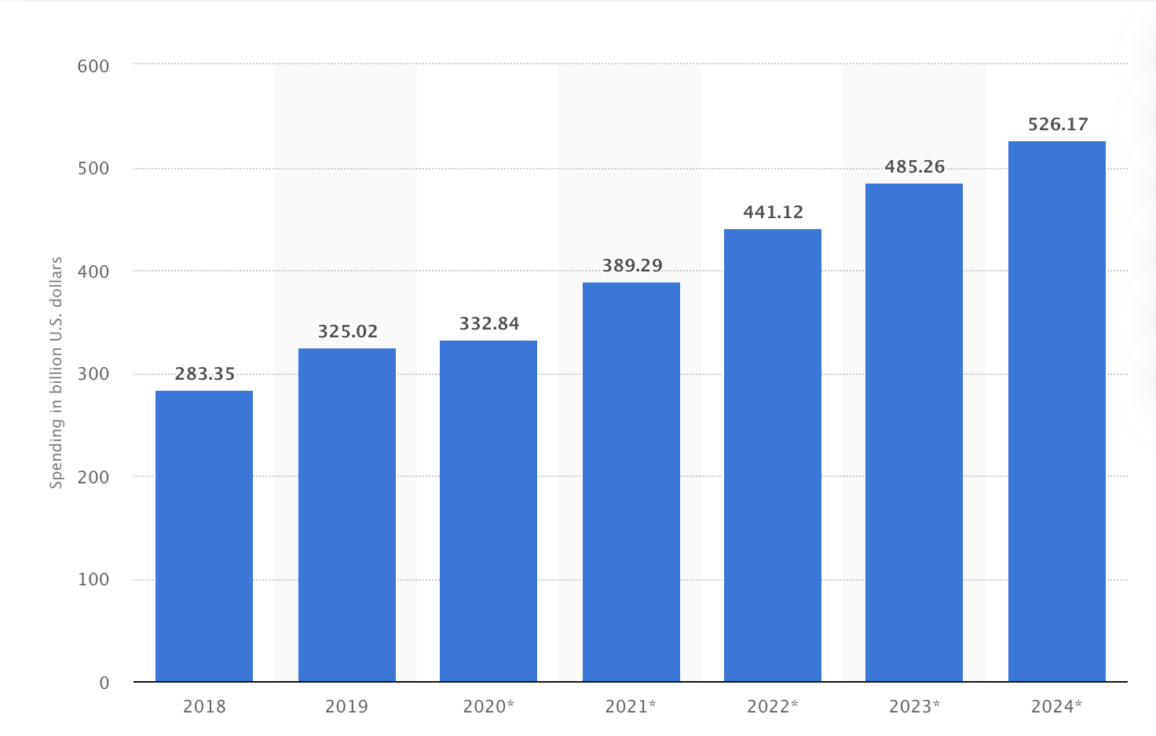
Digital Marketing Is Taking Over the Table.
Source: Digital Advertising Spending
Notes:
Purpose: Emphasize the importance of digital marketing.
TALKING POINTS:
It is estimated that the digital advertising spending worldwide in 2019 amounted to 325 billion U.S. dollars, and, after a drop in 2020 due to coronavirus-related market issues, it will grow to 389 billion dollars in 2021.
Global advertising spending has been consistently increasing since 2010 and is forecasted to reach nearly 548 billion U.S. dollars in 2017. Due to advances in technology and consumer preferences, not all mediums are as heavily invested in it as others. As of 2016, television was still considered the most important medium for advertisers, accounting for an estimated 35.5% of total media ad spend in 2016.

Slide 124

Ask Me Anything
10 minutes
What final questions do you have for your instructor or classmates?
Ask away!
Notes:
Purpose: Facilitate an open discussion to debrief on the previous activity and recap the entire day.
TEACHING TIPS:
What final questions do students have? Have them ask you any remaining questions now.
For remote classrooms:
Invite students to come off mute or take a screenshot of this slide, drop it in the Slack channel, and ask them to thread their responses.

Slide 125

Well Done!
Notes:
TEACHING TIPS:
Share any final thoughts here and encourage students to stay in touch with the GA community.

Slide 126

We Want Your Feedback!
A survey will be sent to you within 24 hours. Please keep an eye out for it and let us know what you liked about this class and what we can improve.
Thank you!
‹#› | © 2020 General Assembly

Slide 127
Questions?

Slide 128
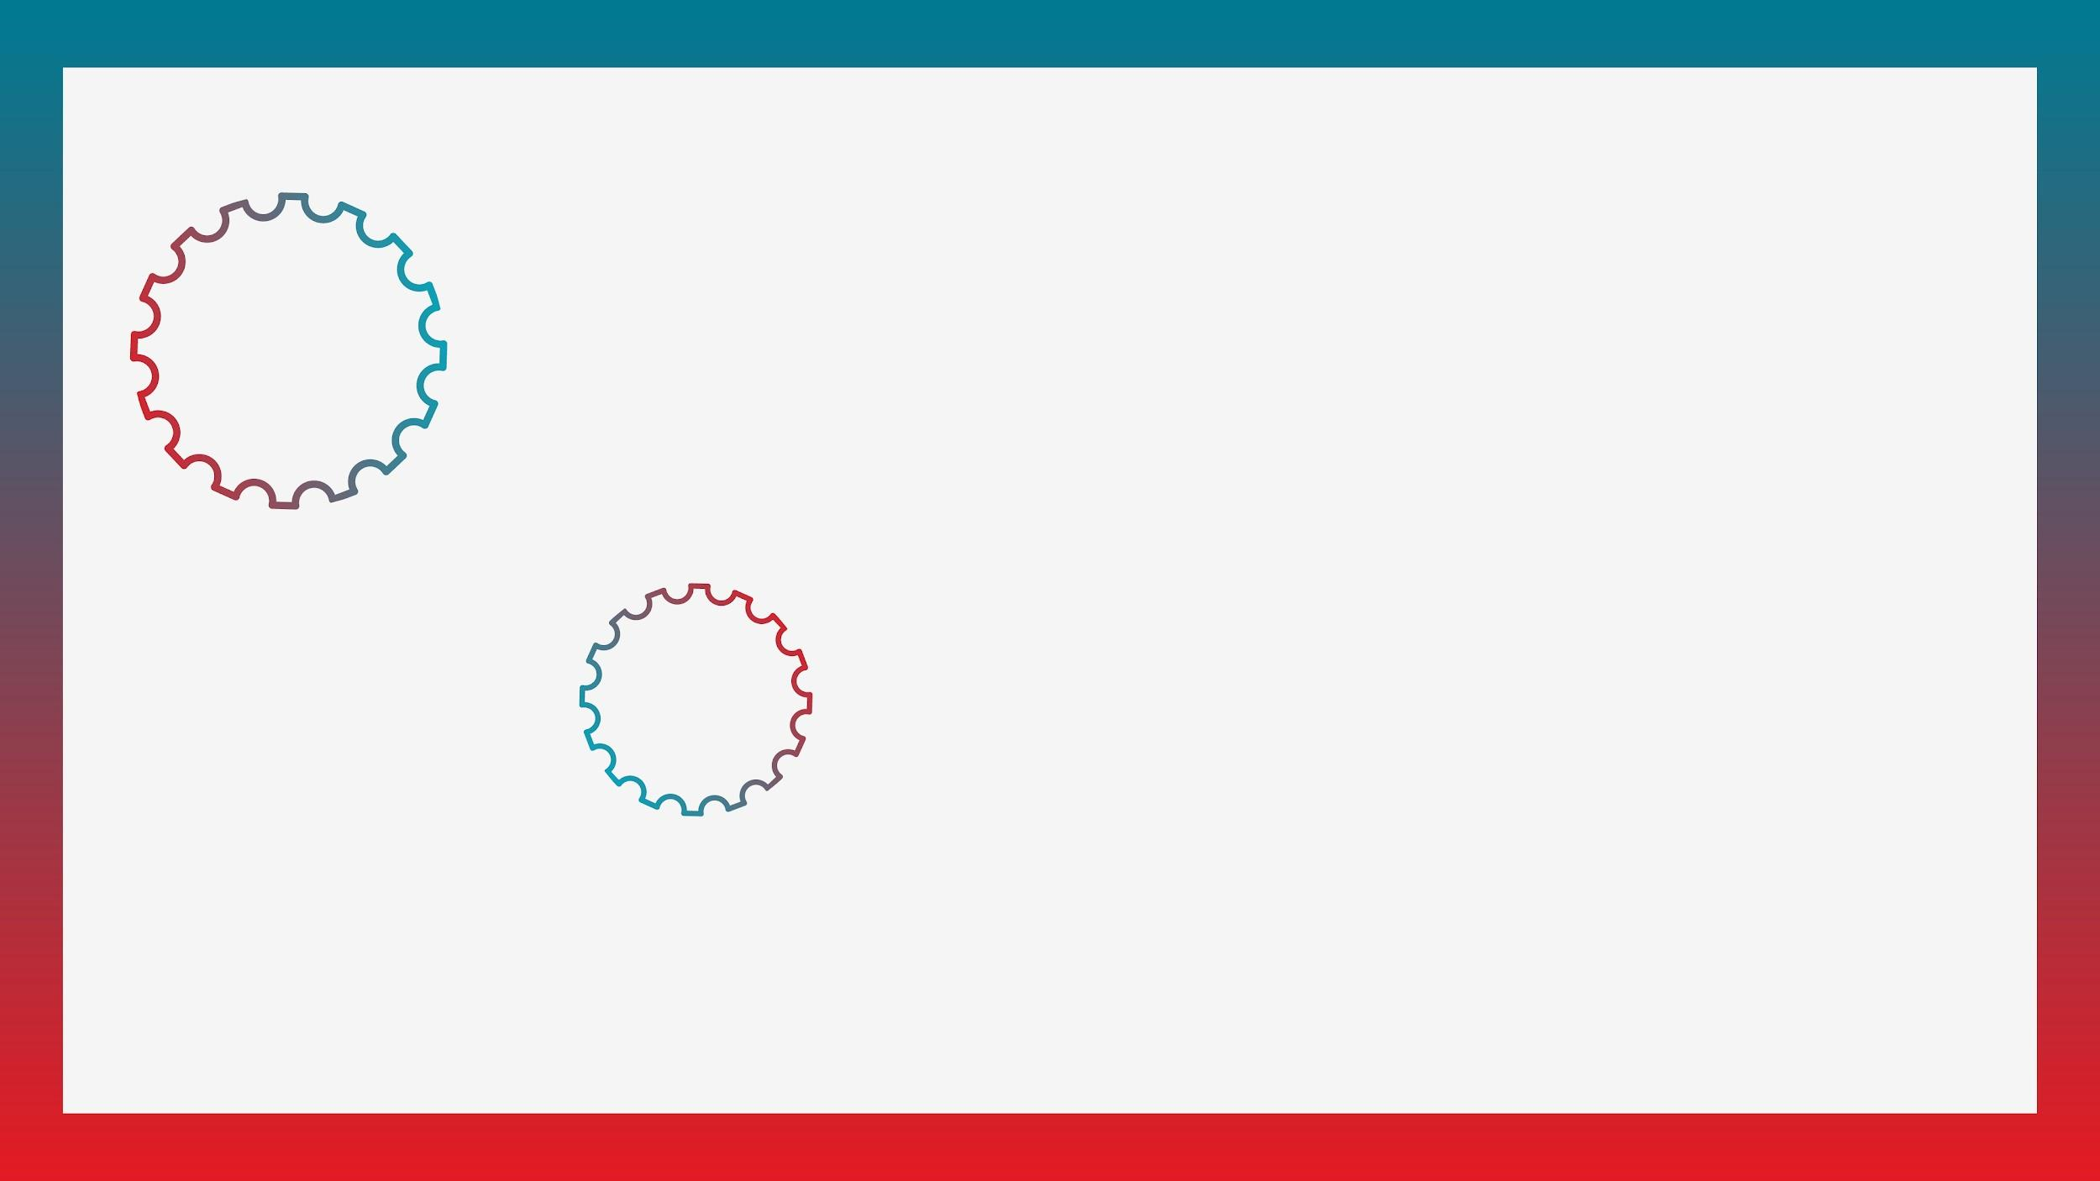

Take Another Workshop
With [Name]!
Sign up at ga.co/[YourName]
Notes:
Instructions for use:
Replace all bracketed “[ ]” text with your name (in the yellow highlighted text) and in the URL in the red box (i.e. ga.co/YourName)
Reach out to your GA point of contact to have a ga.co short link created for you.
Right-click on circle labeled “Your photo” and select ‘Replace image’ > Upload from computer. Select your desired photo from your computer and click ‘Open’.

Slide 129
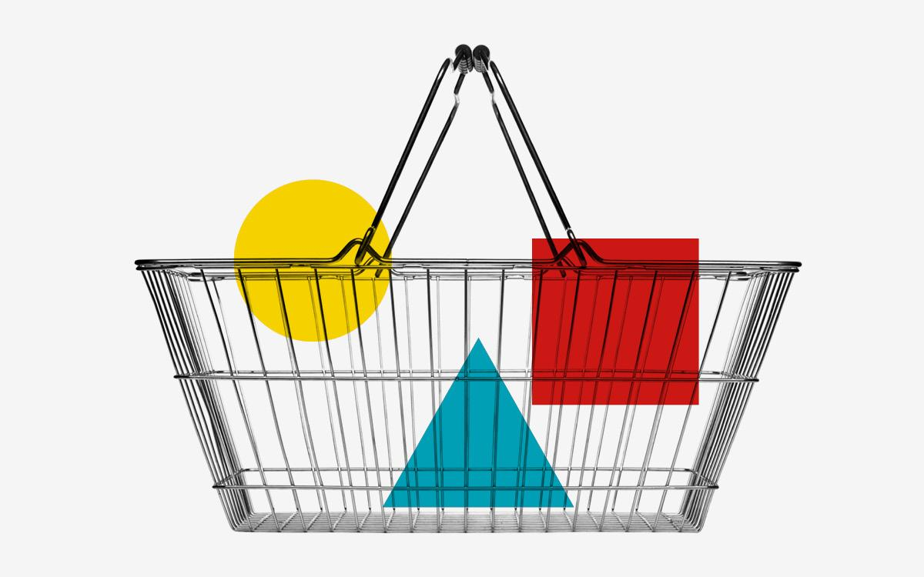
Workshops @ GA
Check out our marketing workshops in:
Digital Marketing
Google Analytics
Social Media
SEO
Content Marketing
Facebook and Instagram
Or explore all of our upcoming workshops: ga.co/workshops
‹#› | © 2020 General Assembly

Slide 130
Take Your Next Step with GA
 | Digital Marketing | Digital Marketing Immersive
Format | Part-time/evenings | Full-time/Monday–Friday
Next Course | <DATES> | <DATES>
Outcome | Learn to plan and execute a marketing campaign, acquire and engage users, and quantify a strategy’s success, ultimately developing a project to showcase your work. | Your best course for career transformation. This full-time digital marketing bootcamp features expert instruction, one-on-one career coaching, and connections to top employers to get you hired
Tuition | $3,950* | $<PRICE>*
*Financing options available.
‹#› | © 2020 General Assembly

Slide 131
Take Your Next Step with GA
 | Digital Marketing
Format | Part-time/evenings
Next Course | <DATES>
Outcome | Learn to plan and execute a marketing campaign, acquire and engage users, and quantify a strategy’s success, ultimately developing a project to showcase your work.
Tuition | $3,950*
*Financing options available.
‹#› | © 2020 General Assembly

Slide 132
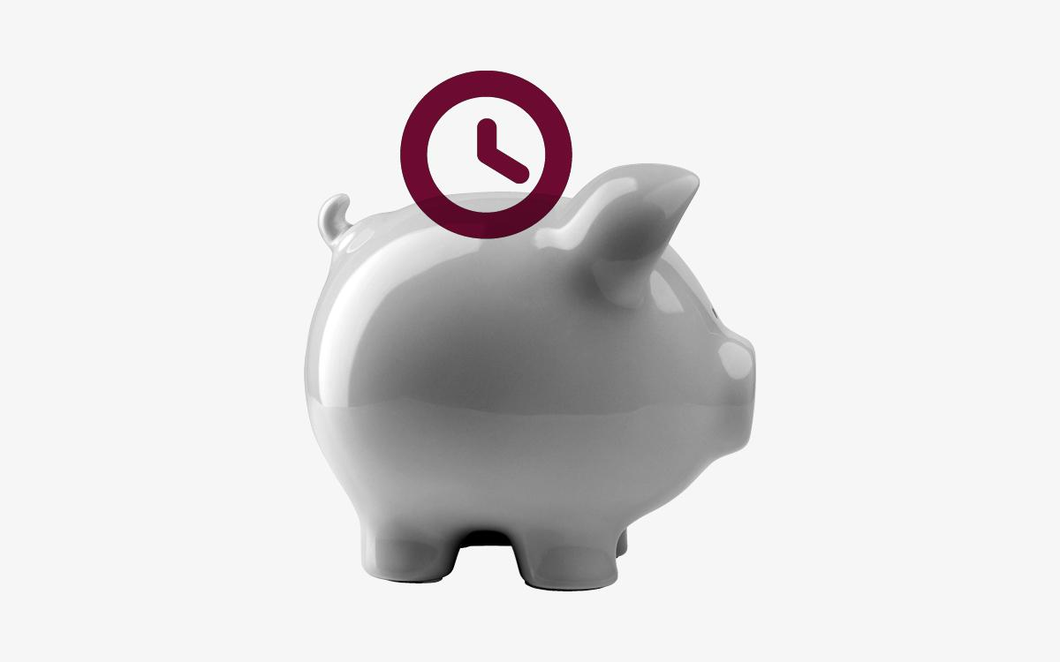
Fund Your Future
We offer a range of student financing and payment options to make your path to education easy, including:
Installment plans
Loans
Scholarships
Income Share Agreements
…and more!
To explore all of our financing options, visit ga.co/financing.
‹#› | © 2020 General Assembly

Slide 133



Let’s Keep In Touch!
Curious about our courses? Speak to our admissions team and they’ll help you find the right path!
Admissions: ga.co/FindYourCourse
Want to experience GA beyond the classroom?
Events: ga.co/events
Follow us!
@generalassembly
@GA
@generalassembly
‹#› | © 2020 General Assembly

Slide 135
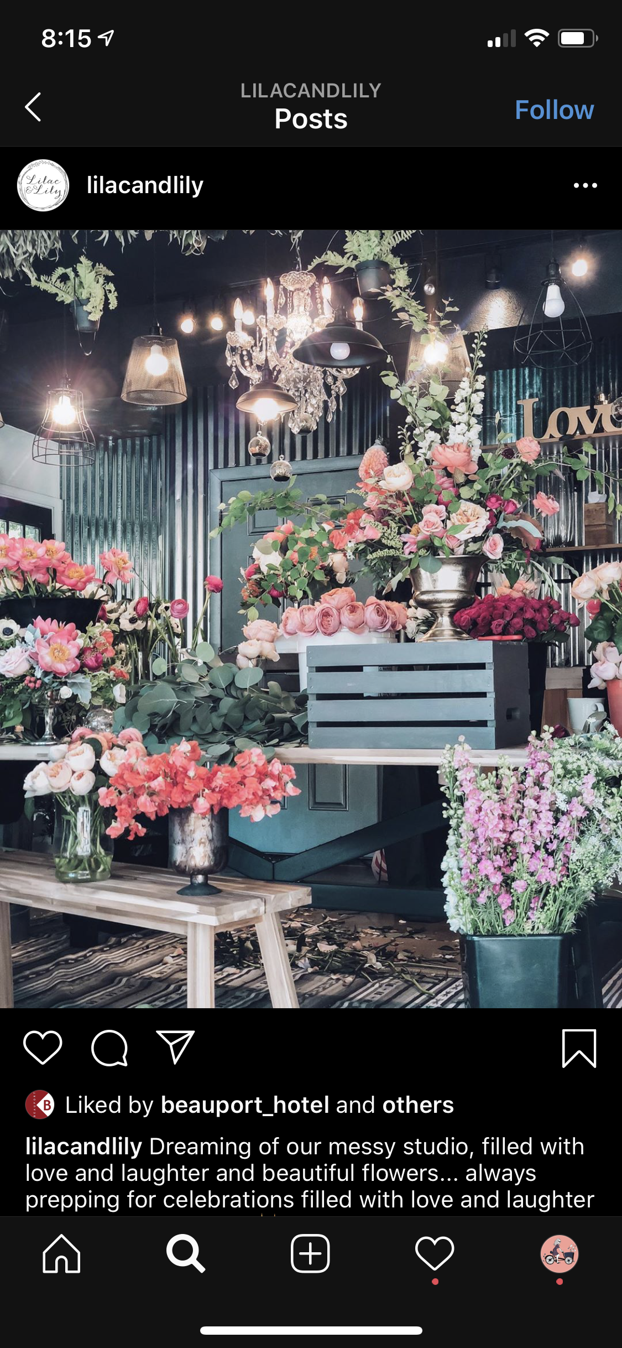
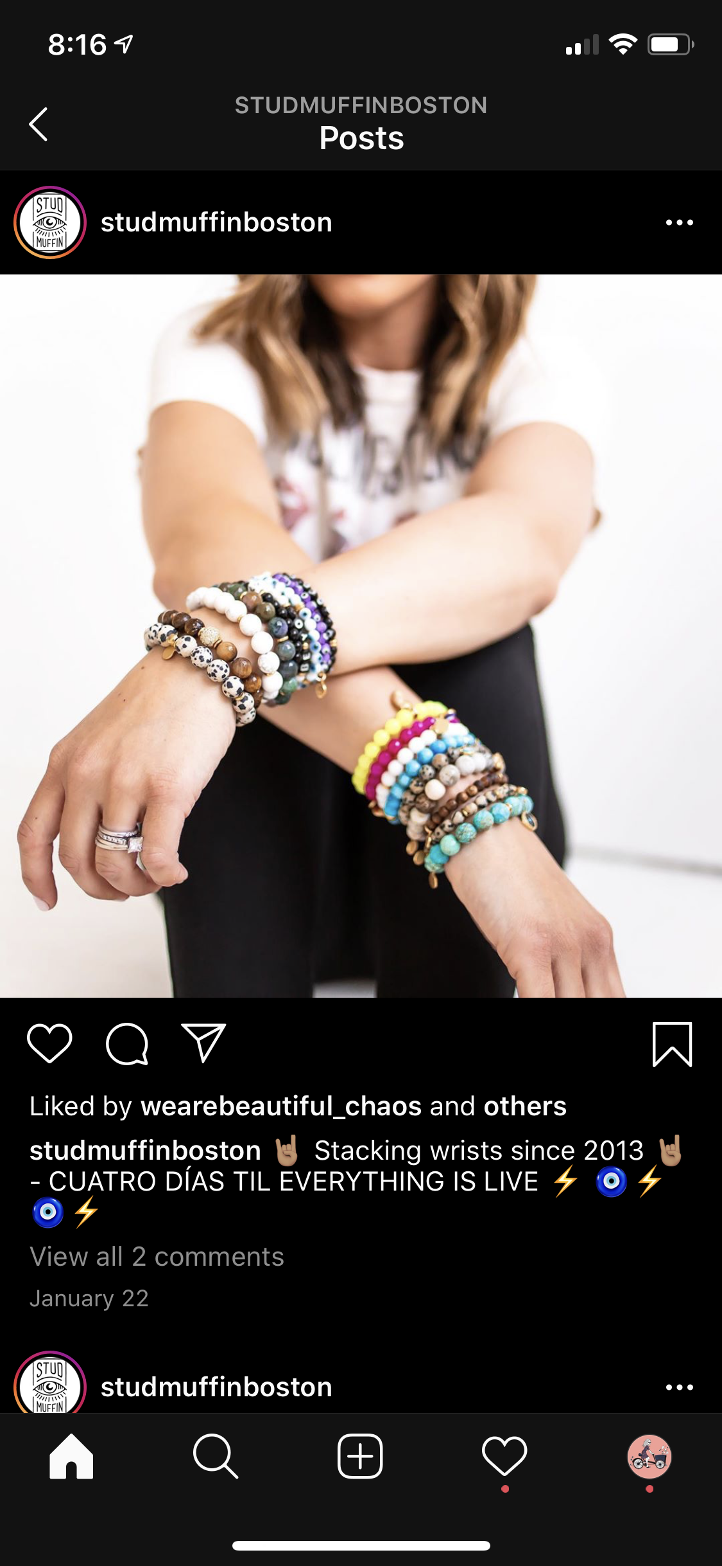

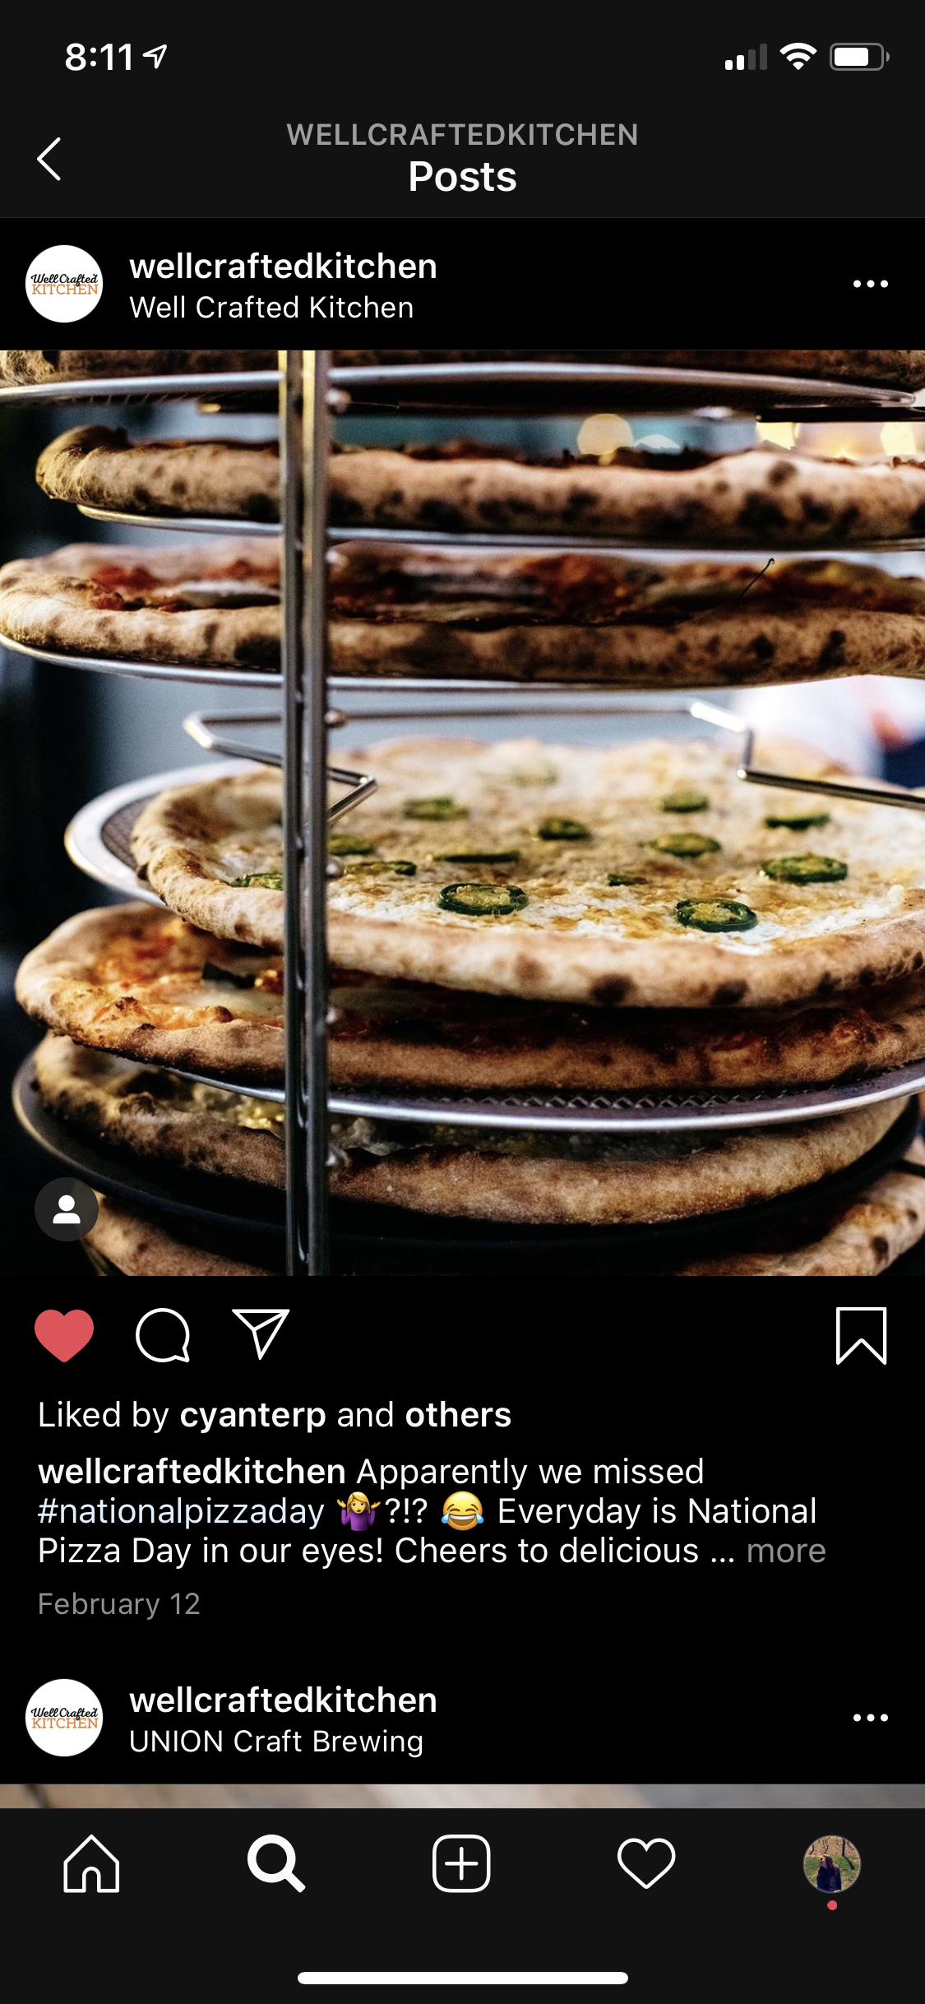


Small Business Examples in Social
Notes:
TALKING POINTS:
All of these have similar things in common as big brands: branding, value, and telling a story!

Slide 136





Additional Business Examples in Social
Notes:
TALKING POINTS:
All of these have multiple things in common: There’s strong branding, they share their value in every single post, and there’s a clear action intended from the user (e.g, like, click, etc.).

